Slide 1
Monday March 30, 2015 Mr. Goblirsch – U.S. History
OBJECTIVE – Students Will Be Able To – SWBAT:
Identify the U.S. policy of containment and analyze Cold War documents.
AGENDA:
WARM-UP: Containment Vocab
CONCEPT: U.S. Containment
DOCUMENTS: Who Started the Cold War?
Containment Vocab WARM-UP: (Follow the directions below)
***5 Minutes***
Define the terms below.
Truman Doctrine 2) Marshall Plan

Slide 2
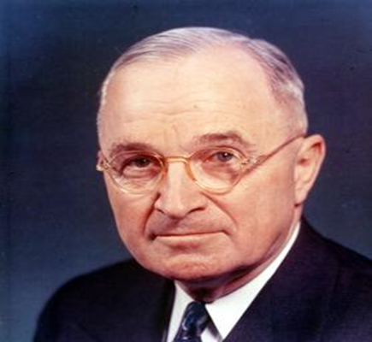
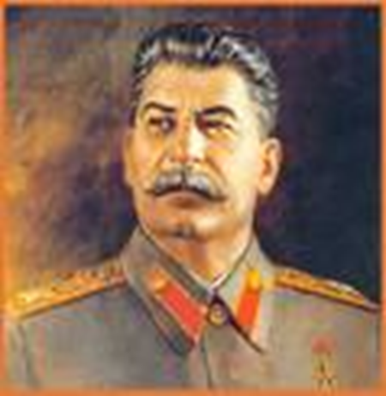
COLD WAR CONFLICTS
U.S.
Containment

Slide 3
PRIOR KNOWLEDGE: CONTAINMENT POLICY
Faced with the Soviet threat, Truman decided it was time to “stop babying the Soviets”
In February 1946, George Kennan, an American diplomat in Moscow, proposed a policy of containment
Containment meant the U.S. would prevent any further extension of communist rule

Slide 4
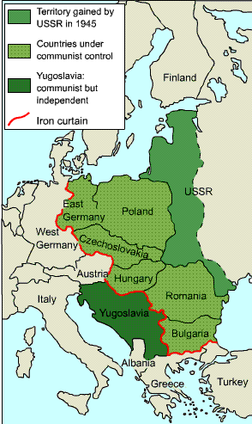
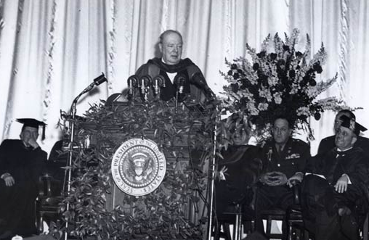
PRIOR KNOWLEDGE: The Iron Curtain
Winston Churchill gave the Iron Curtain speech in 1946
Map of the Iron Curtain

Slide 5
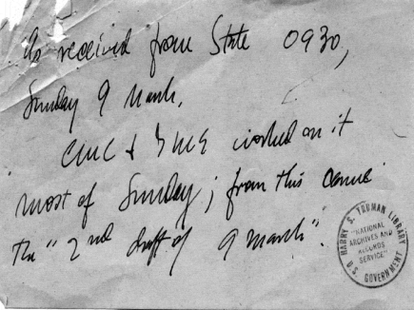
THE TRUMAN DOCTRINE
The American policy of “containment” soon expanded into a policy known as the “Truman Doctrine”
This doctrine, first used in Greece and Turkey in the late 1940s, vowed to provide aid (money & military supplies) to support “free peoples who are resisting outside pressures”
By 1950, the U.S. had given $400 million in aid to Greece and Turkey

Slide 6
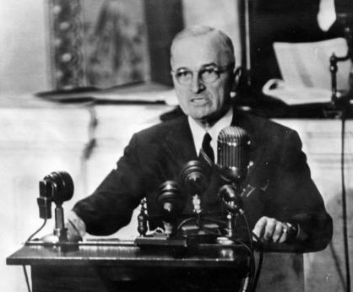
The Truman Doctrine, 1947
President Truman outlined the Truman Doctrine to a joint session of Congress in March of 1947

Slide 7
Structured Academic Discussion
The Truman Doctrine prevented the spread of communism by …

Slide 8
THE MARSHALL PLAN
Post-war Europe was devastated economically
In June 1947, Secretary of State George Marshall proposed a U.S. aid package to European nations
Western Europe accepted the help, while Eastern Europe (Stalin) rejected the aid
Over the next four years 16 European countries received $13 billion in U.S. aid
By 1952 Western Europe’s economy was flourishing
The Marshall Plan helped Western Europe recover economically

Slide 9
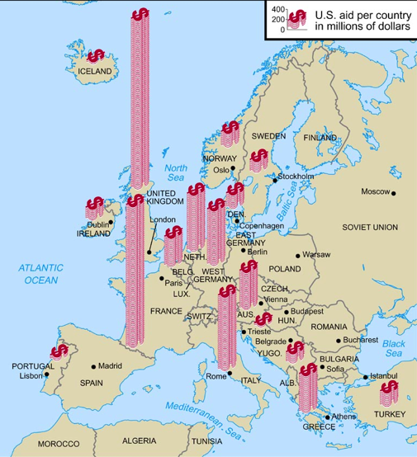
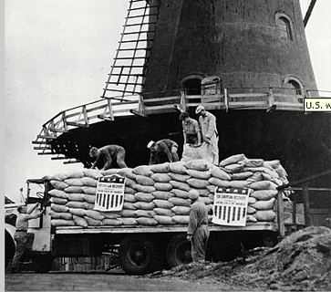
The Marshall Plan, 1947
Photo shows a delivery of wheat from the U.S. being unloaded in Rotterdam, Netherlands
A map showing how the plan’s $20B was distributed by country

Slide 10
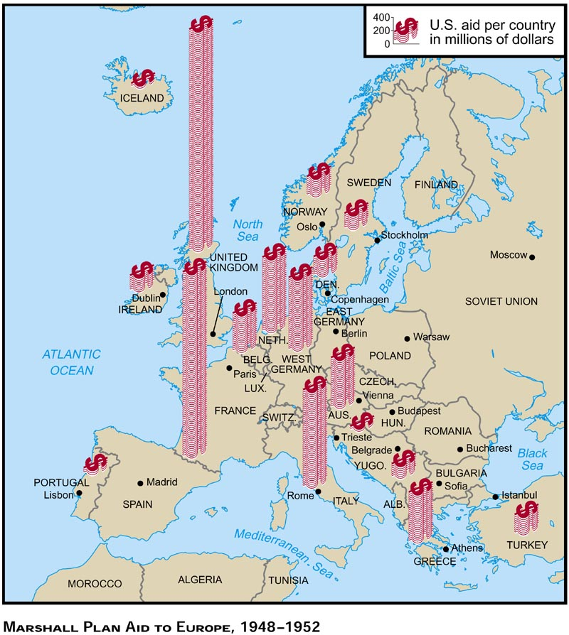
Marshall Plan aid sent to European countries

Slide 11
Structured Academic Discussion
The Marshall Plan prevented the spread of communism by …

Slide 12
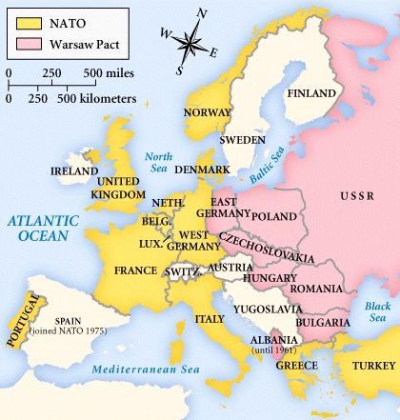
NATO Treaty, 1949. Warsaw Pact, 1955.

Slide 13
Central Historical Question
Who started the Cold War?

