Slide 1
Monday April 20, 2015 Mr. Goblirsch – U.S. History
OBJECTIVE – Students Will Be Able To – SWBAT:
Identify the social and economic characteristics of postwar and 1950s America.
AGENDA:
WARM-UP: 1950s Vocab
CONCEPT: 1950s America
VIDEO: Post-War America (26:00 – 39:00)
CLOSURE: 1950s Summary Questions
*****SBAC Math Testing ALL NEXT WEEK in this class
1950s Vocab WARM-UP: (Follow the directions below)
***5 Minutes***
Define the terms below.
Suburb 4) Baby boom
Franchise 5) Consumerism
Conglomerate 6) “White Flight” (See the bottom of P. 660)

Slide 2
THE POSTWAR BOOM
THE AMERICAN DREAM IN THE 1950S
John Naisbitt

Slide 3
THE AMERICAN DREAM IN THE FIFTIES
After WWII ended, Americans turned their attention to their families and jobs
New businesses and technology created opportunities for many
By the end of the 1950s, Americans were enjoying the highest standard of living in the world
Ozzie and Harriet reflected the perfect American family

Slide 4
REMARKABLE ECONOMIC RECOVERY
Experts who predicted a postwar depression were proved wrong as they failed to consider the $135 billion in savings Americans had accumulated from defense work, service pay, and investments in war bonds
Americans were ready to buy consumer goods

Slide 5
POSTWAR AMERICA
After WWII, returning vets faced a severe housing shortage
In response to the crisis, developers used assembly-line methods to mass-produce houses
Developer William Levitt bragged that his company could build a home in 16 minutes for $7,000
Suburbs were born
With the help of the GI Bill, many veterans moved into suburbs

Slide 6
THE SUBURBAN LIFESTYLE
Most Americans worked in cities, but fewer and fewer of them lived there
New highways and the affordability of cars and gasoline made commuting possible
Of the 13 million homes built in the 1950s, 85% were built in suburbs
For many, the suburbs were the American Dream
The American Dream complete with a white picket fence

Slide 7
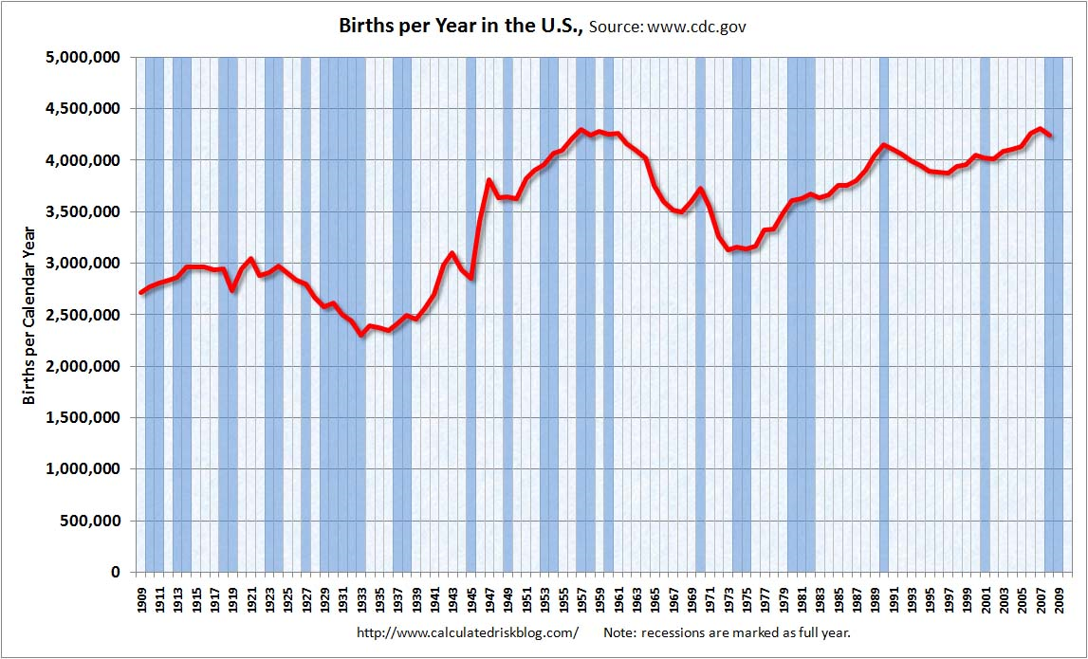
THE BABY BOOM
During the late 1940s and through the early 1960s the birthrate in the U.S. soared
At its height in 1957, a baby was born in America every 7 seconds (over 4.3 million babies in ’57 alone)
Baby boomers represent the largest generation in the nation’s history

Slide 8
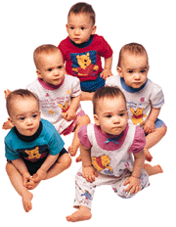
WHY SO MANY BABIES?
Why did the baby boom occur when it did?
Husbands returning from war
Decreasing marriage age
Desirability of large families
Confidence in economy
Advances in medicine

Slide 9
IMPACT OF BABY BOOM
As a result of the baby boom 10 million students entered elementary schools in the 1950s
California built a new school every 7 days in the late ’50s
Toy sales reached an all-time high in 1958 when $1.25 billion in toys were sold

Slide 10
WOMEN’S ROLES IN THE 1950S
During the 1950s, the role of homemaker and mother was glorified in popular magazines, movies and television

Slide 11
WOMEN AT WORK
Those women who did work were finding job opportunities limited to fields such as nursing, teaching and office support
Women earned far less than man for comparable jobs

Slide 12
THE AUTOMOBILE CULTURE
After the rationing of WWII, inexpensive and plentiful fuel and easy credit led many to buy cars
By 1960, over 60 million Americans owned autos

Slide 13
INTERSTATE HIGHWAY ACT 1956
In 1956 Ike authorized a nationwide highway network – 41,000 miles of road linking America

Slide 14
THE INTERSTATE HIGHWAY SYSTEM
“Automania” spurred the construction of roads linking major cities while connecting schools, shopping centers and workplaces to residential suburbs

Slide 15
IMPACT OF THE HIGHWAY
The Interstate Highway system resulted in:
More trucking
Less railroad
More suburbs, further away
Trucking is the #1 means of moving cargo in the United States today

Slide 16
RISE OF CONSUMERISM
By the mid-1950s, nearly 60% of Americans were members of the middle class
Consumerism (buying material goods) came to be equated with success and status

Slide 17
NEW PRODUCTS
One new product after another appeared in the marketplace
Appliances, electronics, and other household goods were especially popular
The first credit card (Diner’s Club) appeared in 1950 and American Express was introduced in 1958
Personal debt increased nearly 3x in the 1950s

Slide 18
THE ADVERTISING AGE
The advertising industry capitalized on runaway consumerism by encouraging more spending
Ads were everywhere
Ad agencies increased their spending 50% during the 1950s
Advertising is everywhere today in America

Slide 19
POP CULTURE
A new era of mass media led by television emerged in the 1950s
In 1948, only 9% of homes had T.V
In 1950, 55% of homes had T.V.
By 1960, 90% of American homes had T.V.

Slide 20
THE POSTWAR BOOM
THE AMERICAN DREAM IN THE 1950S
John Naisbitt

Slide 21
POSTWAR AMERICA
After WWII, returning vets faced a severe ____________________
In response to the crisis, developers used ___________ methods to ______________ houses
Developer William Levitt bragged that his company could build a home in 16 minutes for $7,000
___________ were born
With the help of the GI Bill, many veterans moved into suburbs

Slide 22
THE SUBURBAN LIFESTYLE
Most Americans worked in cities, but fewer and fewer of them lived there
_____________ and the affordability of ________ and ____________ made commuting possible
Of the 13 million homes built in the 1950s, 85% were built in __________
For many, the suburbs were the ____________________
The American Dream complete with a white picket fence

Slide 23
THE BABY BOOM
During the late 1940s and through the early 1960s the birthrate in the U.S. _____________
At its height in ____, a baby was born in America every _____ seconds (over _____ million babies in ’57 alone)
________________ represent the largest generation in the nation’s history

Slide 24
IMPACT OF BABY BOOM
As a result of the baby boom 10 million students entered _________________ in the 1950s
___________ built a new school every 7 days in the late ’50s
________ reached an all-time high in 1958 when $1.25 billion in toys were sold

Slide 25
WOMEN’S ROLES IN THE 1950S
During the 1950s, the role of _________ and __________ was glorified in popular magazines, movies and television

Slide 26
INTERSTATE HIGHWAY ACT 1956
In 1956 Ike authorized a nationwide highway network – _________ miles of road linking America

Slide 27
RISE OF CONSUMERISM
By the mid-1950s, nearly 60% of Americans were members of the _________________
Consumerism (buying material goods) came to be equated with ______________ and ______________

Slide 28
THE ADVERTISING AGE
The advertising industry capitalized on runaway _______ by encouraging more ______________
Ads were everywhere
Ad agencies increased their spending _____ during the 1950s
Advertising is everywhere today in America

Slide 29
POP CULTURE
A new era of mass media led by television emerged in the 1950s
In 1948, only ___ of homes had T.V
In 1950, ______ of homes had T.V.
By 1960, _______ of American homes had T.V.

