Slide 1
Thursday February 19, 2015 Mr. Goblirsch – American Government
OBJECTIVE – Students Will Be Able To – SWBAT:
- Describe the flaws & proposed reforms of the Electoral College system.
AGENDA:
WARM-UP: Electoral College
JIGSAW: Electoral College: Flaws & Proposed Reforms
TASK: Red State, Blue State
*****Workbook Pgs. 62 & 63 – DUE TOMORROW
Electoral College WARM-UP: (Follow the directions below)
***5 minutes***
Analyze the Political Cartoon on P. 383 & the Chart on P. 381.
Look at the cartoon on P. 383, what details in the cartoon suggest that the electoral college is one of the most complex parts of the political process?
Look at the chart on P. 381, how do these results illustrate the significance of the “winner-take-all” factor of the electoral college?
Look at the chart on P. 381, what affect do you think Ralph Nader’s third-party candidacy had on the election results?

Slide 2
ELECTORAL COLLEGE JIGSAW
JIGSAW GROUPS:
A – Read P. 379 – 381 (Senate & Small State)
B – Read P. 382 – 383 (Large & Medium State)
A B
3 ELECTORAL COLLEGE FLAWS |  | 3 PROPOSED REFORM SYSTEMS
1st DEFECT – |  | DISTRICT PLAN – Pros / Cons
2nd DEFECT – |  | PROPORTIONAL PLAN – Pros / Cons
3rd DEFECT – |  | DIRECT POPULAR ELECTION – Pros / Cons

Slide 3
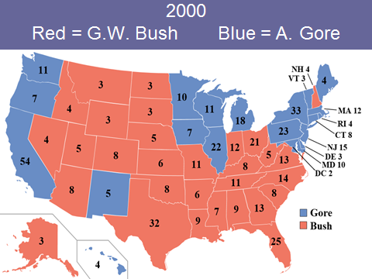
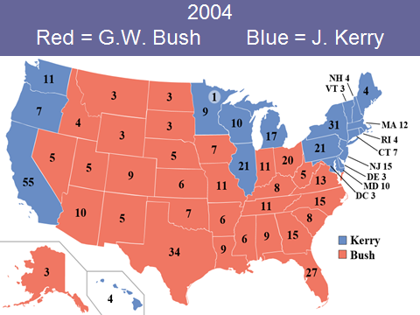
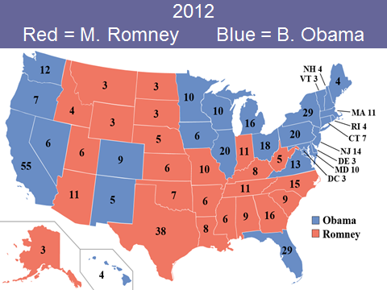

Slide 4
Red State, Blue State
Red States | Blue States | Swing States
1) List all of the states that voted Republican in all 4 elections from 2000 – 2012 2) Add up the number of Red States 3) Add up the electoral votes of the Red States (use the 2012 electoral numbers) 4) What regions are primarily Red States | 1) List all of the states that voted Democrat in all 4 elections from 2000 - 2012 2) Add up the number of Blue States 3) Add up the electoral votes of the Blue States (use the 2012 electoral numbers) 4) What regions are primarily Blue States | 1) List all of the states that flipped at least one time during the elections of 2000 – 2012 2) Add up the number of Swing States 3) Add up the electoral votes of the Swing States (use the 2012 electoral numbers)

Slide 5
Red State, Blue State
Red States | Blue States | Swing States
1) 2) 3) 4) | 1) 2) 3) 4) | 1) 2) 3)

Slide 6
Red State, Blue State
Solid Red States | Solid Blue States | Swing States
Texas – 38 Georgia – 16 Tennessee – 11 Arizona – 11 Missouri – 10 Alabama – 9 South Carolina – 9 Louisiana – 8 Kentucky – 8 Oklahoma – 7 Arkansas – 6 Kansas – 6 Mississippi – 6 Utah – 6 Nebraska – 5 West Virginia – 5 Idaho – 4 Alaska – 3 Montana -3 North Dakota – 3 South Dakota – 3 Wyoming – 3 2) 22 states 3) 180 electoral votes (need 90 for 270) 4) South, Midwest | California – 55 New York – 29 Pennsylvania – 20 Illinois – 20 Michigan – 16 New Jersey – 14 Washington – 12 Massachusetts – 11 Maryland – 10 Minnesota – 10 Wisconsin – 10 Connecticut – 7 Oregon – 7 Hawaii – 4 Maine – 4 Rhode Island – 4 Delaware – 3 Vermont – 3 Washington DC – 3 2) 19 states 3) 239 electoral votes (need 31 for 270) 4) West Coast, Northeast, Great Lakes | Florida – 29*** Ohio – 18*** North Carolina – 15 Virginia – 13 Indiana – 11 Colorado – 9 Iowa – 6 Nevada – 6 New Mexico – 5 New Hampshire – 4 2) 10 states 3) 116 electoral votes “up for grabs”

Slide 7
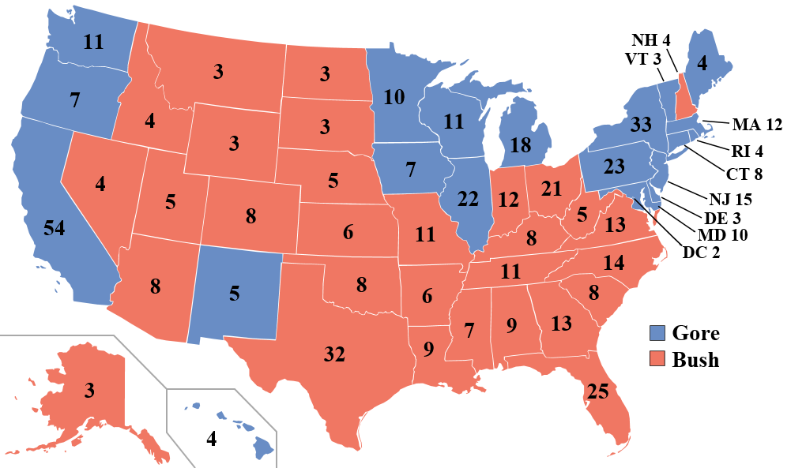
2000 Red = G.W. Bush Blue = A. Gore

Slide 8
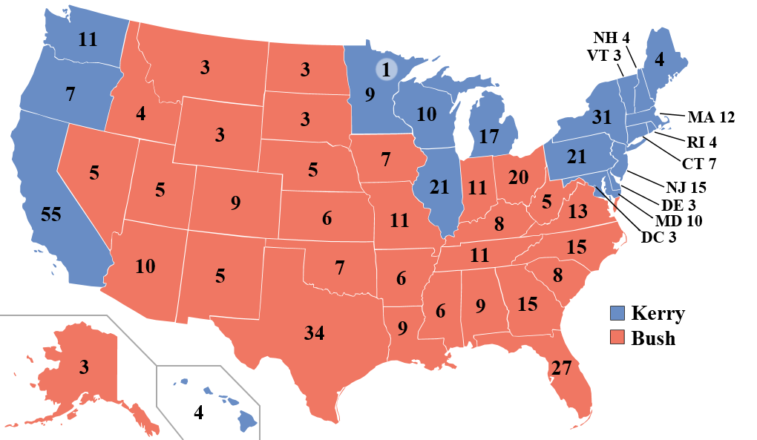
2004 Red = G.W. Bush Blue = J. Kerry

Slide 9
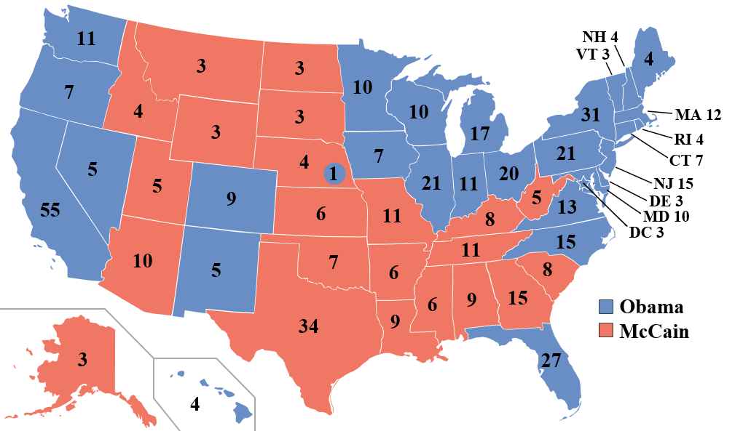
2008 Red = J. McCain Blue = B. Obama

Slide 10
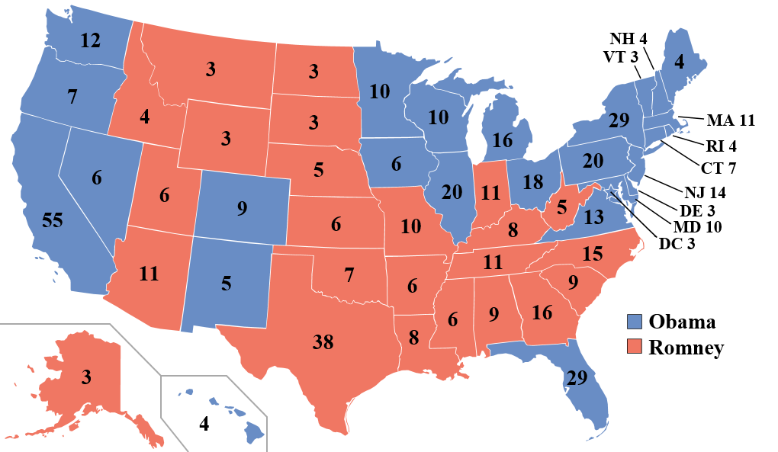
2012 Red = M. Romney Blue = B. Obama

Slide 11
EXIT TICKET: What do you think of the Electoral College?
The Founding Fathers created the Electoral College as our system to elect the President of the U.S.. Write a paragraph defending or opposing the Electoral College system. Use examples as to why you think it is a good system or a flawed system.
Hints: Not popular vote, winner-take-all in States, Apportionment of Electors

Slide 12
Proposed Reforms to the Electoral College
I. District Plan
A. District electors of state cast vote for the winner of their district
B. State’s 2 at-large electors (representing senate seats) cast vote for candidate who wins entire state
Pros – eliminates winner-take-all system
Cons – increases importance of congressional redistricting and gerrymandering

Slide 13
Proposed Reforms to the Electoral College
II. Proportional Plan
A. Candidates receive electoral votes in proportion to popular vote in state
Pros – eliminates winner-take-all system and would more closely resemble popular vote
Cons – 3rd party influence, less chance to get 270 majority

Slide 14
Proposed Reforms to the Electoral College
III. Direct Popular Election
A. President would be selected by popular vote, most votes wins
Pros – everyone’s vote is equal, eliminates confusion of Electoral College
Cons – State’s lose identity in election, Huge impact on candidates campaign time, effort, and money

