Slide 1
Monday February 23, 2015
Mr. Goblirsch – American Government
OBJECTIVE – Students Will Be Able To – SWBAT:
- Identify the departments & members of the Presidential Cabinet.
AGENDA:
WARM-UP: Cabinet Vocab
REVIEW: Red State, Blue State
ACTIVITY: Presidential Cabinet Speed Dating
ASSIGNMENT: Workbook Pg. 73
EXIT DISCUSSION: 3 Important Departments
Cabinet Vocab WARM-UP: (Follow the directions below)
***5 minutes***
Define the terms below using the glossary of your textbook.
Executive departments
Secretary
Attorney General

Slide 2
Red State, Blue State
Red States | Blue States | Swing States
1) List all of the states that voted Republican in all 4 elections from 2000 – 2012 2) Add up the number of Red States 3) Add up the electoral votes of the Red States (use the 2012 electoral numbers) 4) What regions are primarily Red States | 1) List all of the states that voted Democrat in all 4 elections from 2000 - 2012 2) Add up the number of Blue States 3) Add up the electoral votes of the Blue States (use the 2012 electoral numbers) 4) What regions are primarily Blue States | 1) List all of the states that flipped at least one time during the elections of 2000 – 2012 2) Add up the number of Swing States 3) Add up the electoral votes of the Swing States (use the 2012 electoral numbers)

Slide 3
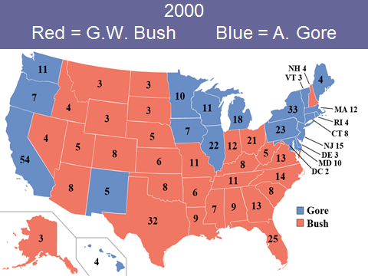
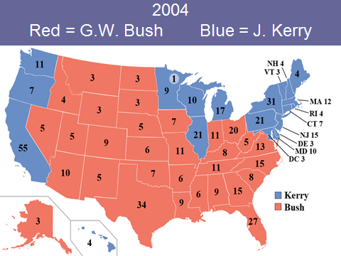

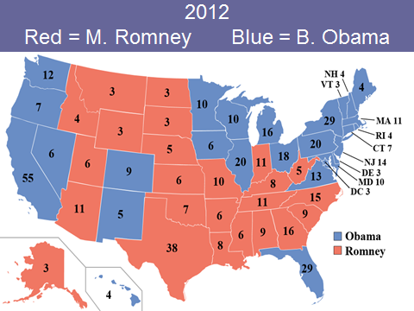

Slide 4
Red State, Blue State
Red States | Blue States | Swing States
1) TX - 38 2) 3) 4) | 1) CA - 55 2) 3) 4) | 1) FL - 29 2) 3)

Slide 5
Red State, Blue State
Solid Red States | Solid Blue States | Swing States
Texas – 38 Georgia – 16 Tennessee – 11 Arizona – 11 Missouri – 10 Alabama – 9 South Carolina – 9 Louisiana – 8 Kentucky – 8 Oklahoma – 7 Arkansas – 6 Kansas – 6 Mississippi – 6 Utah – 6 Nebraska – 5 West Virginia – 5 Idaho – 4 Alaska – 3 Montana -3 North Dakota – 3 South Dakota – 3 Wyoming – 3 2) 22 states 3) 180 electoral votes (need 90 for 270) 4) South, Midwest | California – 55 New York – 29 Pennsylvania – 20 Illinois – 20 Michigan – 16 New Jersey – 14 Washington – 12 Massachusetts – 11 Maryland – 10 Minnesota – 10 Wisconsin – 10 Connecticut – 7 Oregon – 7 Hawaii – 4 Maine – 4 Rhode Island – 4 Delaware – 3 Vermont – 3 Washington DC – 3 2) 19 states 3) 239 electoral votes (need 31 for 270) 4) West Coast, Northeast, Great Lakes | Florida – 29*** Ohio – 18*** North Carolina – 15 Virginia – 13 Indiana – 11 Colorado – 9 Iowa – 6 Nevada – 6 New Mexico – 5 New Hampshire – 4 2) 10 states 3) 116 electoral votes “up for grabs”

Slide 6
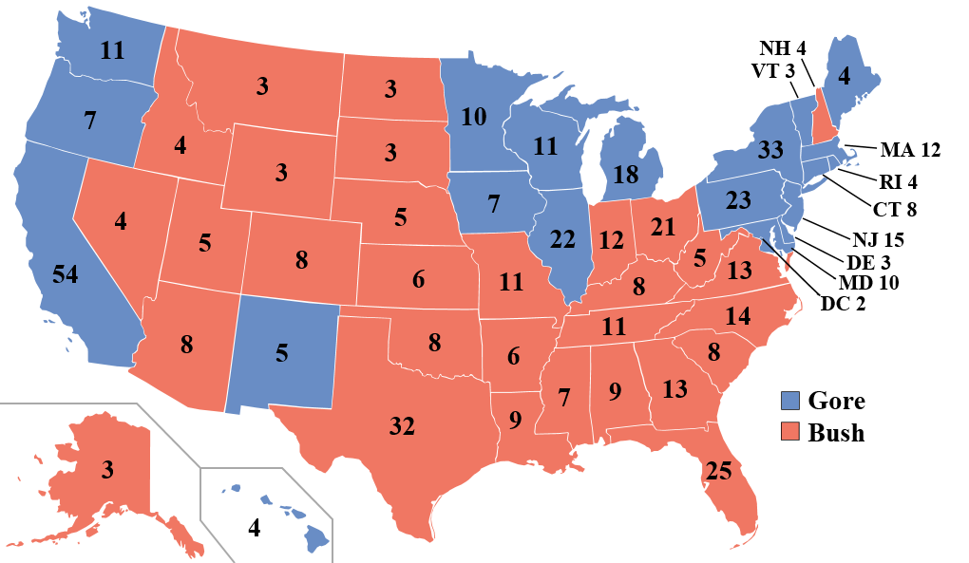
2000
Red = G.W. Bush Blue = A. Gore

Slide 7
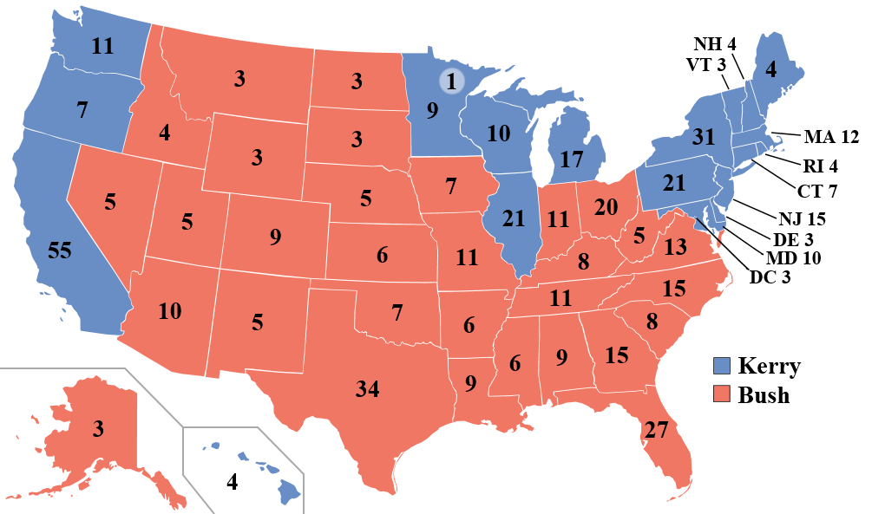
2004
Red = G.W. Bush Blue = J. Kerry

Slide 8
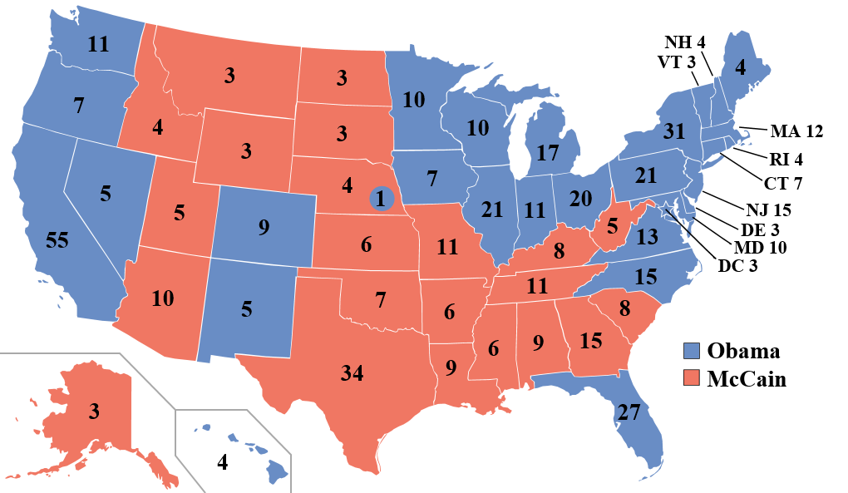
2008
Red = J. McCain Blue = B. Obama

Slide 9
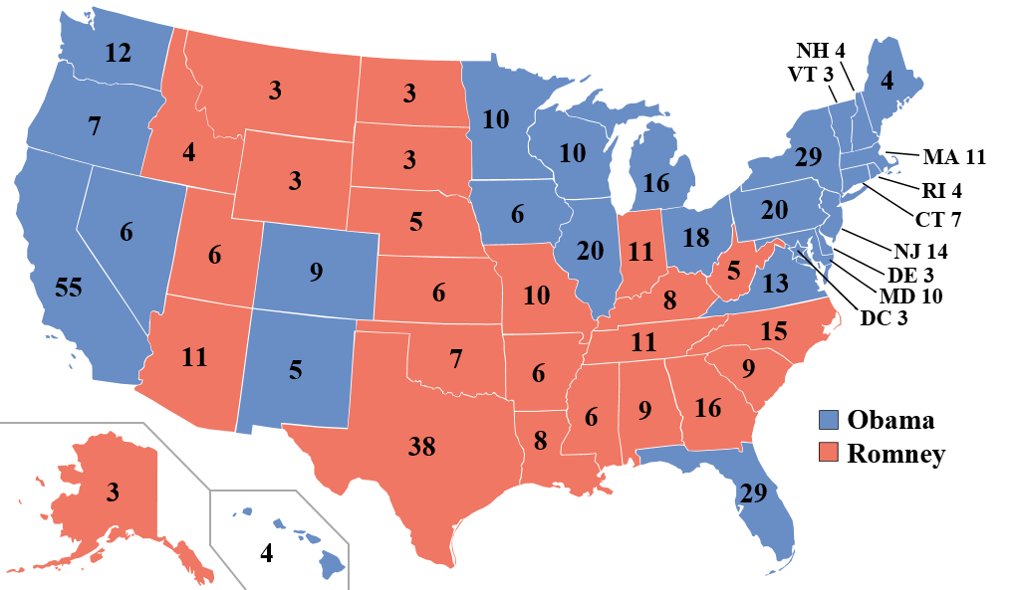
2012
Red = M. Romney Blue = B. Obama

Slide 10

The President:
Cabinet

Slide 11

The Cabinet
All are confirmed by the Senate
and serve at the discretion of the President
(only 12 have been rejected since 1789)
Very diverse
Bipartisan
High turnover
Loyalty to department trumps loyalty to president = opposite of the white house departments
“The Constitution … contains no suggestion of a meeting of all the department heads, in consultation over general government matters. The Cabinet is a mere creation of the President’s will … It exists only by custom. If the President desired to dispense with it, he could do so.”
- William Howard Taft

Slide 12
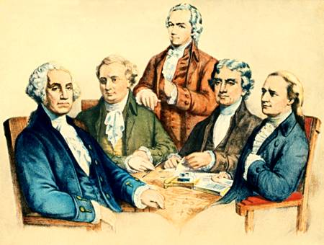
Washington's Cabinet
Washington
Knox
Jefferson
Randolph
Hamilton

Slide 13
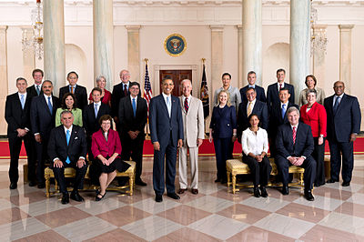
The President’s Cabinet
(Executive Departments)

Slide 14
Presidential Cabinet
Speed Dating
Around the room you will find the 15 Presidential Cabinet members
You will have 1 ½ minutes per Cabinet member to “get to know them”
Complete the Presidential Cabinet chart as you visit each Cabinet member

Slide 15

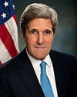
The State Department
Secretary John Kerry
  February 1, 2013
Advises President on foreign policies, negotiates agreements with foreign countries, and represents the U.S. in international organizations.

Slide 16
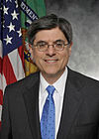

The Department of the Treasury
Secretary Jack Lew
February 28, 2013
Produces coins and bills, collects taxes, borrows money and manages public debt, and enforces alcohol, tobacco, and firearm laws.

Slide 17
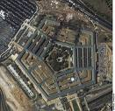
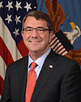

The Department of Defense
(The Pentagon)
Secretary Ashton Carter
  February 17, 2015
Provides military forces to deter war and protect the nations security.

Slide 18

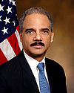
The Justice Department
Attorney General Eric H. Holder Jr.
February 2, 2009
Prosecutes those accused of violating federal law, provides legal advice to President, represents the U.S. in court, enforces federal laws, and operates federal prisons

Slide 19


The Department of the Interior
Secretary Sally Jewell
  April 12, 2013
Manages public lands, wildlife refuges, and national parks, operates hydroelectric power plants, and helps Native Americans manage their affairs.

Slide 20
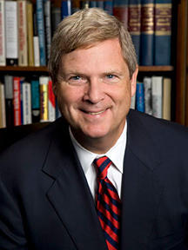

Department of Agriculture
Secretary Thomas J. Vilsack
  January 20, 2009
Manages national forests, inspects food, assists farmers and ranchers, and administers food stamp and school lunch programs

Slide 21
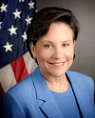

Department of Commerce
Secretary Penny Pritzker
June 26, 3013
Conducts census, grants patents and registers trademarks, and promotes international trade, economic growth, and technical development.

Slide 22

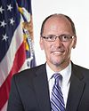
Department of Labor
Secretary:
Thomas Perez
  July 23, 2013
Enforces federal laws on minimum wages, maximum hours and safe working conditions.
Operates job training programs
Administers unemployment insurance and workers’ compensation programs.

Slide 23

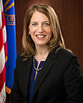
        Department of Health & Human Services
        Secretary
        Sylvia Mathews Burwell
  June 9, 2014
Funds health care research programs.
Conducts programs to prevent and control disease.
Enforces pure food and drug laws.
Administers Medicare and Medicade

Slide 24

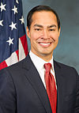
Department of Housing &
Urban Development
Secretary
Julian Castro
  July 28, 2014
Operates home-financing and public housing programs
Enforces fair housing laws

Slide 25

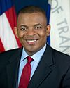
Department of Transportation
Secretary
Anthony Fox
  July 2, 2013
Administers programs to promote and regulate highways, mass transit, railroads, waterways, air travel, and oil and gas pipelines.

Slide 26

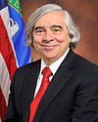
Department of Energy
Secretary
Ernest Moniz
  May 21, 2013
Promotes production of renewal energy, fossil fuels, and nuclear energy.
Transmits and sells hydroelectric power.
Conducts nuclear weapons research and production.

Slide 27

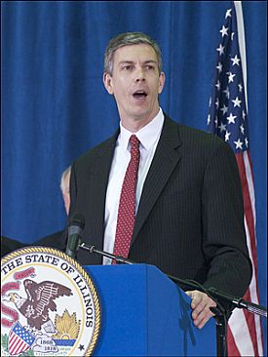
Department of Education
Secretary
Arne Duncan
  January 20, 2009
Administers federal aid to schools.
Conducts educational research.

Slide 28

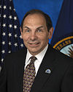
Department of Veteran Affairs
Secretary
Robert McDonald
July 30, 2014
Administers benefits, pensions, and medical programs for veterans of the armed forces.
Over sees military cemeteries.

Slide 29

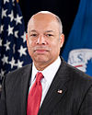
Department of
Homeland Security
Secretary
Jeh Johnson
  December 23, 2013
Border and transportation security.
Emergency preparedness and response.
Chemical, biological, radiological, nuclear defense.
Information analysis and an infrastructure protection.

Slide 30
Presidential Cabinet
DISCUSSION
REFER TO YOUR PRESIDENTIAL CABINET CHART
DISCUSS WITH YOUR PARTNER:
  What 3 Executive Departments do you feel are the most important? Why?

Slide 31
Presidential Cabinet
Assignment
READ CH 15-3 Pg. 424 - 429
COMPLETE WORKBOOK PG. 73

