Slide 1
Tuesday March 3, 2015 Mr. Goblirsch – American Government
OBJECTIVE – Students Will Be Able To – SWBAT:
- Identify key information relating to the President and Executive branch.
AGENDA:
WARM-UP: Supreme Court Decision
DISCUSSION: Executive Office of the President Outline
REVIEW: Presidential Roles/Titles
QUICK WRITE: Presidential Salary
CLOSURE: Need to Know for President Quiz
***ASSIGNMENT: Workbook Pg. 69 – DUE TODAY
*President Quiz TOMORROW
*****Presidential Speeches to be Delivered on FRIDAY*****
Supreme Court Decision WARM-UP: (Follow the directions below)
***5 minutes***
Read the Supreme Court case arguments for US v. Nixon on P. 409. Answer each question below by writing a sentence (or 2) brief summary.
Summarize the issue of the case
Summarize the Arguments for Nixon
Summarize the Arguments for the U.S.

Slide 2
The West Wing
The Mansion
The Oval Office

Slide 3
Read P. 419 - 422 Complete the outline below
D. Executive Office of the President (“right arm”)
1. White House Office:
Chief of Staff –
Press Secretary –
2. National Security Council –
3. OMB (Office of Management & Budget)

Slide 4
The Executive Office of the President:
The President’s Closest Advisors and the Pinnacle of Power

Slide 5
The Chief of Staff
Name: Denis McDonough
Since January 2013
Job Description:
Manage the president's schedule
Decide who is allowed to meet with the president.
Select key White House staff and supervise them
Structure the White House staff system
Control the flow of people into the Oval Office
Manage the flow of information
Protect the interests of the President
Negotiate with Congress, other members of the executive branch, and extra governmental political groups to implement the President's agenda

Slide 6
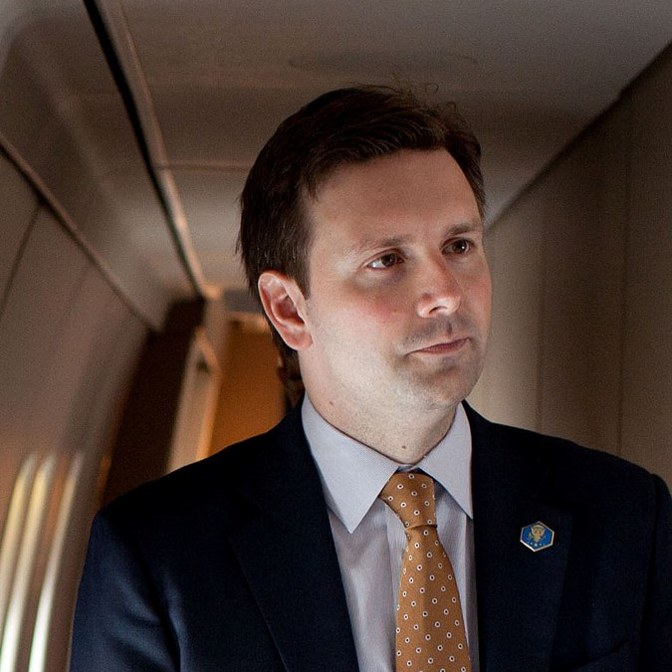
The White House Press Secretary
Name: Josh Earnest
Since June 2014
Job Description:
Act as spokesperson for the government administration
Responsible for collecting information about actions and events within the president's administration and around the world
Interacting with the media, generally in a daily press briefing

Slide 7
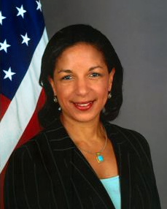
The National Security Advisor
Name: Susan Rice
Since July 2013
Job Description:
Chief advisor to President on national security issues
Serves on the National Security Council
Operates from the White House Situation Room in times of crisis, updating the President on the latest events of the crisis

Slide 8
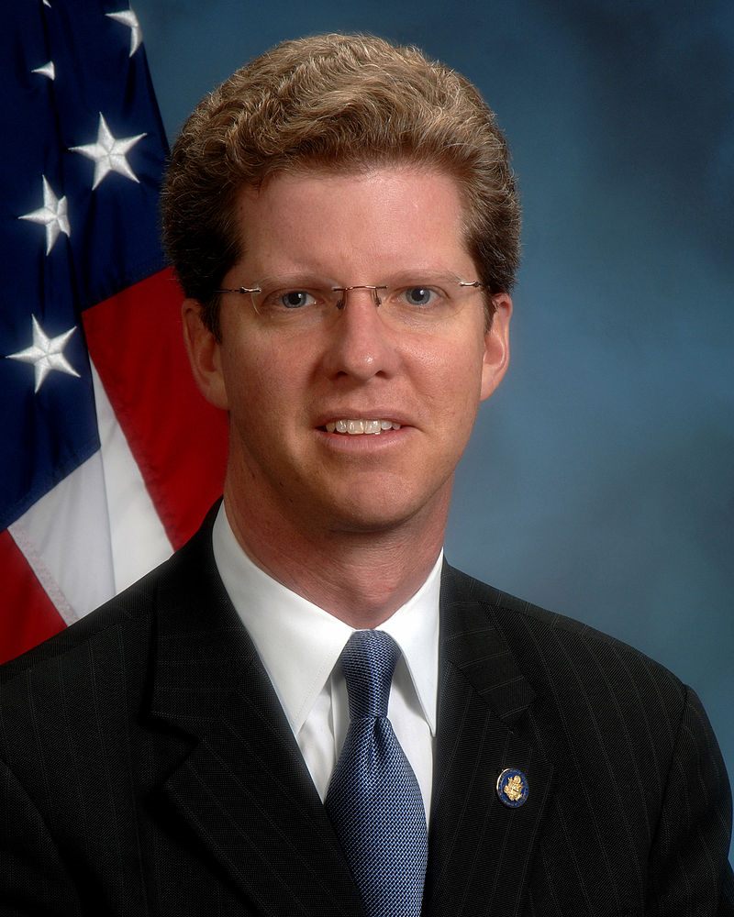
OMB Director (Office of Management and Budget)
Name: Shaun Donovan
Job Description:
Assist the President in overseeing the preparation of the federal budget and supervise its administration
Evaluate the effectiveness of agency programs, policies, and procedures
Set funding priorities
Ensure that agency reports, rules, testimony, and legislation are consistent with the President’s Budget

Slide 9
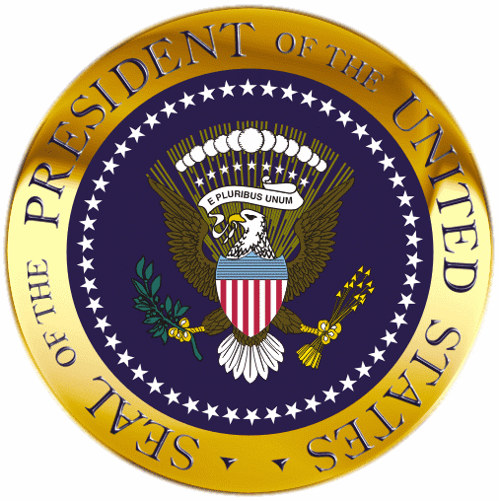
Presidential Roles/Titles
Chief of State
Ceremonial head of U.S. government
Chief Executive
Executive power from the Constitution
Chief Administrator
Head of Executive Branch of Government
Chief Diplomat
National spokesperson and determines foreign policy
Commander in Chief
Controls armed forces
Chief Legislator
Initiates, suggests, requests, insists, and demands Congress enact much of its major legislation
Chief of Party
Leader of his political party
Chief citizen
Represents the American people and their interests

Slide 10
The President: Powers

Slide 11
Executing the Law
As chief executive, the President executes (enforces, administers, carries out) the provisions of federal law.
The oath of office instructs the President to carry out the laws of the land.
The other provision is the Constitution’s command that “he shall take care that the laws be faithfully executed.”
Executive Power – enforce laws
head of more than 2 million executive branch employees, federal agencies
Executive order – enforce policies & programs enacted by Congress
(1948 – Truman desegregated the armed forces)
Impoundment – refusal to spend money Congress has appropriated
Appoint executive heads/Cabinet of advisors
(w/ Senate consent) (remove appointed officials)
1
3
4
Chapter 14, Section 2

Slide 12
The Ordinance Power
The President has the power to issue executive orders. An executive order is a directive, rule, or regulation that has the effect of law. (Implied Power)
The power to issue these orders, the ordinance power, arises from two sources: the Constitution and acts of Congress.
Although not specifically mentioned in the Constitution, the ordinance power is clearly intended.
The size of government has caused Congress to delegate more and more discretion to the President and presidential subordinates.
1
3
4
Chapter 14, Section 2

Slide 13
Commander in Chief
The Constitution makes the President the commander in chief of the nation’s armed forces.
Making Undeclared War
Many Presidents have used the armed forces abroad without a declaration of war.
Wartime Powers
The President’s powers as commander in chief are far greater during a war than they are in normal times.
The War Powers Resolution
The War Powers Resolution of 1973 limits the President’s war-making powers.
Commander in Chief – national security
Send forces into action w/o formal declaration of war w/ or w/o Congressional approval
Make key military decisions (including using the atomic bomb)
Special War Powers (more control at home) price controls, government control of war industries, rationing
Emergency Powers – rioting, natural disaster (flood, hurricane, tornado)
1
2
4
Chapter 14, Section 3

Slide 14
Judicial Powers
The Constitution gives the President the power to “...grant reprieves and pardons for offenses against the United States, except in cases of impeachment.” —Article II, Section 2, Clause 1
A reprieve is the postponement of the execution of a sentence.
A pardon is legal forgiveness for a crime.
These powers of clemency (mercy or leniency) may be used only in cases of federal crimes.
Judicial Powers – appoint federal judges (w/ Senate consent)
1
2
3
Chapter 14, Section 4

Slide 15
The Power to Make Treaties
A treaty is a formal agreement between two or more sovereign states.
The President, usually through the secretary of state, negotiates these international agreements.
All treaties must pass approval by a two thirds of the members present vote in the Senate.
(1) Appoints & accepts ambassadors and other diplomats;
1
2
4
Chapter 14, Section 3

Slide 16
Executive Agreements
An executive agreement is a pact between the President and the head of a foreign state, or a subordinate.
Unlike treaties, executive agreements do not require Senate consent.
1
2
4
Chapter 14, Section 3

Slide 17
The Power of Recognition
The power of recognition is exercised when the President, acting for the United States, acknowledges the legal existence of another sovereign state.
The President may show American displeasure with the conduct of another country by asking for the recall of that nation’s ambassador or other diplomatic representatives in this country.
The official is declared to be persona non grata, or an unwelcome person.
1
2
4
Chapter 14, Section 3

Slide 18
The Appointment Power
With Senate consent, the President names most of the top-ranking officers of the Federal Government, including:
(1) ambassadors and other diplomats;
(2) Cabinet members and their top aides;
(3) the heads of such independent agencies as the EPA and NASA;
(4) all federal judges, attorneys, and U.S. marshals;
(5) all officers in the armed forces.
1
3
4
Chapter 14, Section 2

Slide 19
The Removal Power
The Historical Debate
Debate ensued in the First Congress as to whether the President could remove appointees without the consent of the Senate.
The view that the President may remove the officials he appoints without Senate consent has prevailed over time.
In general, the President may remove any appointees except federal judges.
1
3
4
Chapter 14, Section 2

Slide 20
Legislative Powers
Recommending Legislation
The Constitution provides that the President shall report to Congress on the state of the Union and recommend necessary legislation.
This power is often called the message power.
The Veto Power
All legislation passed by Congress is sent to the President for approval.
If the President disapproves of a bill, he can veto it. That veto can only be overturned by a two-thirds vote of both houses of Congress.
Other Legislative Powers
According to Article II, Section 3 of the Constitution, only the President can call a Congress into special session.
1
2
3
Chapter 14, Section 4

Slide 21
QUICK WRITE
TAKE 10 MIN TO ANSWER THE FOLLOWING. You can refer to your notes to make your case.
Congress has the power of determining the President’s salary. At $400,000 a year, the President’s salary is far more than the average citizen, but far less than the yearly income of many wealthy Americans. You are a member of Congress: write a well-written ½ page quick write defending your position about whether the President’s pay is fair, whether he deserves a raise, or whether he is over-paid. Be sure to use factual support based on his responsibilities.
(HINT – Powers & Roles we’ve covered).

Slide 22
NEED TO KNOW FOR QUIZ: President & Executive Branch
20 MC Questions
Role of primary election
Electoral College system
# of Electoral votes needed to win
3 Presidential qualifications in the Constitution
Oath of office to protect what
Line of succession
12th Amendment
22nd Amendment
Presidential Cabinet
Executive Order
Executive Agreement
Executive Privilege
Power granting control over the armed forces
Treaty Power
Presidential roles/titles

Slide 23
STATE FLAG POSTER CONTEST RESULTS BY PERIOD
PERIOD 3 –
4 - Mississippi
3 - Oregon
2 - Senate
1 – Florida
PERIOD 4 –
4 – New York
3 – Senate
2 – Maine
1 – Georgia
PERIOD 5 –
4 – Oregon
3 – New York
2 – Hawaii
1 – Senate
PERIOD 6 –
4 – Colorado
3 – California
2 – Nevada
1 – Senate

Slide 24
STATE FLAG POSTER CONTEST RESULTS OVERALL
OVERALL RESULTS
3 – P3 – Senate
2 – P5 – Senate
1 – P3 – Florida

