Slide 1
Tuesday March 10, 2015 Mr. Goblirsch – American Government
OBJECTIVE – Students Will Be Able To – SWBAT:
- Identify the non-legislative & denied powers of Congress.
AGENDA: 5th & 6th Periods ONLY
WARM-UP: Taxing Power
Presidential Election
CHART: Impeachment Process P. 312
CONCEPT: Non-Legislative & Denied Powers
ASSIGNMENT: Review Questions
***Presidential Inauguration Speeches FRIDAY
Taxing Journal WARM-UP: (Follow the directions below)
***5 minutes***
Write a paragraph journal entry on the topic below.
The congressional power to tax and spend is important because _____________________________________. Explain.

Slide 2
Tuesday March 10, 2015 Mr. Goblirsch – American Government
OBJECTIVE – Students Will Be Able To – SWBAT:
- Identify the non-legislative & denied powers of Congress.
AGENDA: 3rd & 4th Periods ONLY
WARM-UP: Taxing Power
CHART: Impeachment Process P. 312
CONCEPT: Non-Legislative & Denied Powers
ASSIGNMENT: Review Questions
***Presidential Inauguration Speeches FRIDAY
Taxing Journal WARM-UP: (Follow the directions below)
***5 minutes***
Write a paragraph journal entry on the topic below.
The congressional power to tax and spend is important because _____________________________________. Explain.

Slide 3
Ch 11 CONCEPT: Congress: Non-Legislative
Non-Legislative Powers
Select President (HR)
No majority in Electoral college = House selects the president
Senate selects the VP
Confirmation Power; Appointments (SN – “Senatorial courtesy”)
Ratification Power; Treaties (SN – 2/3 vote required)
Amendment Power (propose w/ 2/3 vote in each house)
Investigation Power - Not a trial.
1. Have power to subpoena witnesses. Witness may be prosecuted for perjury or contempt.
Watkins v. United States, 1957. Witnesses have constitutional rights, just like in a trial
2. Congress can grant immunity
Legislative Oversight: Congress makes laws. President supposed to enforce the law. Oversight allows the legislature to see how the President is doing in enforcing the law.
Each standing committee to oversee how the law is being administered within their area of responsibility
Party Politics. Congress may not oversee President from same party that closely. “Where there is publicity to be gained, there is oversight to be had.”

Slide 4
CONCEPT: Investigatory Power
1
2
3
4
Chapter 11, Section 5

Slide 5
Ch 11 CONCEPT: Congress: Denied
Powers Denied
Bill of Rights (can’t pass a law infringing rights – Supreme Court interprets)
Can’t suspend habeas corpus
Can’t pass bill of attainder, (laws that punish without a trial)
Can’t pass ex post facto laws (laws that make an act a crime that was legal when it was committed)
Can’t tax exports

Slide 6
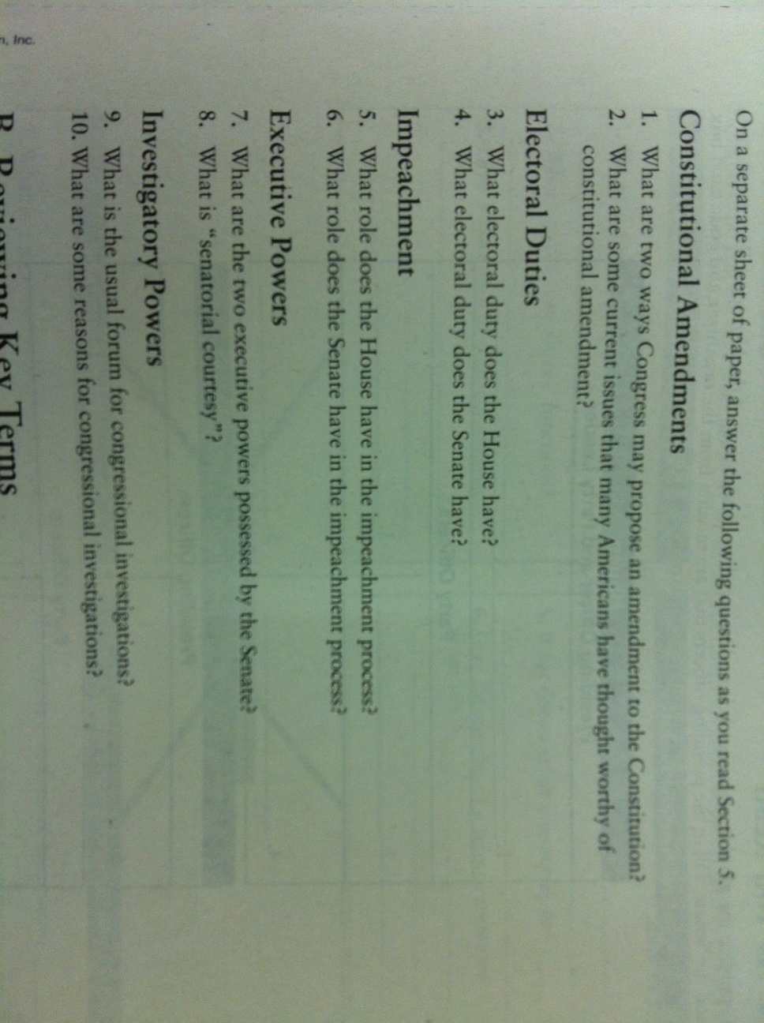
CONGRESS REVIEW QUESTIONS
Refer to Ch. 11 Sec. 5 (Pgs. 310 – 314) to answer the questions.

Slide 7
PRESIDENTIAL SPEECHES & VOTE
SPEECH
Presidential candidate, campaign managers, & tech manager come to podium
Tech manager films speech. Email to cgoblirsch@ceresusd.net
Campaign Manager #1 will introduce the Presidential candidate using the profile
Campaign Manager #2 will stand behind the Presidential candidate displaying campaign posters/materials
Presidential candidate will deliver their speech
PRIMARY VOTE
Open Primary – Vote for one candidate from each political party
All votes will be tallied. The top vote getting candidate from each political party will win that parties nomination.
GENERAL ELECTION - TOMORROW
The teacher will announce the candidate representing each party, then the Presidential candidates will announce their Vice-Presidential “ticket” mate
Students will vote in the general election for 1 presidential candidate ONLY
Election results will be determined TOMORROW

Slide 8
5th PRIMARY BALLOT
Representative/Senator Name:
_________________________
_______________________
_____ (R) Representative Mendoza
_____ (R) Representative Rodriguez
_____ (D) Senator Blandino
_____ (I) Representative Zurita

Slide 9
5th General Election BALLOT
Representative/Senator Name:
_________________________
_______________________
_____ (R) Representative Rodriguez
_____ (D) Senator Blandino
_____ (I) Representative Zurita

Slide 10
6th PRIMARY BALLOT
Representative/Senator Name:
_________________________
_______________________
_____ (R) Representative Williams, Jeff
_____ (R) Representative Ramirez, Efren
_____ (D) Representative Padilla, Julio
_____ (I) Representative Palafox, Mario
_____ (I) Representative Ruiz

Slide 11
6th General Election BALLOT
Representative/Senator Name:
_________________________
_______________________
_____ (R) Representative Williams
_____ (D) Representative Padilla
_____ (I) Representative Palofox

Slide 12
CONCEPT: The Necessary and Proper Clause
The Necessary and Proper Clause gives to Congress the power:
“To make all Laws which shall be necessary and proper for carrying into Execution the foregoing Powers and all other Powers vested by this Constitution in the Government of the United States, or in any Department or Officer thereof.”
—Article I, Section 8, Clause 18
1
2
3
5
Chapter 11, Section 4

Slide 13
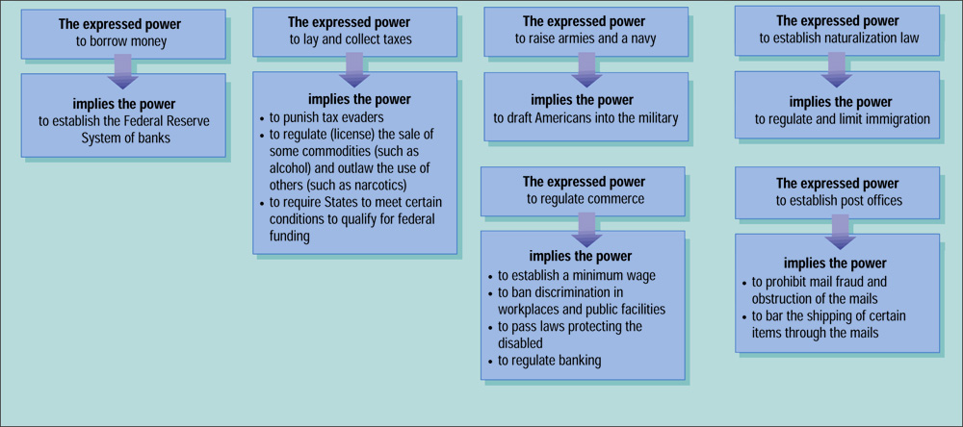
The Implied Powers of Congress
1
2
3
5
Chapter 11, Section 4

