Slide 1
Wednesday April 22, 2015 Mr. Goblirsch – American Government
OBJECTIVE – Students Will Be Able To – SWBAT:
- Explain the procedures of the Supreme Court
AGENDA:
WARM-UP: Supreme Court Vocab
PRIOR KNOWLEDGE: Constitutional Principles
CONCEPT: Judicial Review - Marbury v. Madison (P. 518)
CHART: Procedures of the Supreme Court
***HW DUE NEXT TUESDAY – Jury Duty Interviews***
Supreme Court Vocab WARM-UP: (Follow the directions below)
***5 minutes***
Define the terms below.
Writ of certiorari 4) Majority opinion
Certificate 5) Concurring opinion
Precedent 6) Dissenting opinion

Slide 2
HW: Jury Duty Interviews
Conduct 3 interviews of people who have had jury duty. Ask them to recall their impressions of the experience.
(EX. – What was the case? How long did it last? How did the deliberations go? What’s the best excuse you heard to try and get out of jury duty? Etc.)
Try to find people who have actually served during the trial, not just people who were dismissed.
After conducting the interview, write a brief paragraph summary of each person’s responses.

Slide 3
PRIOR KNOWLEDGE: Constitutional Principles
Separation of Powers w/ Checks & Balances – judiciary is independent from other 2 branches
Limited Government / Constitutionalism – government is limited by the constitution: Courts are defenders of the constitution
Judicial Review – power of courts to determine constitutionality: Supreme Court is final authority

Slide 4
Judicial Review
The Supreme Court first asserted its power of judicial review in the case of Marbury v. Madison (1803).
READ AS A CLASS P. 518
Why did William Marbury not get his justice position?
How did the Court’s decision affect the role of the judicial branch in our system of government?
The Court’s decision laid the foundation for its involvement in the development of the American system of government.

Slide 5
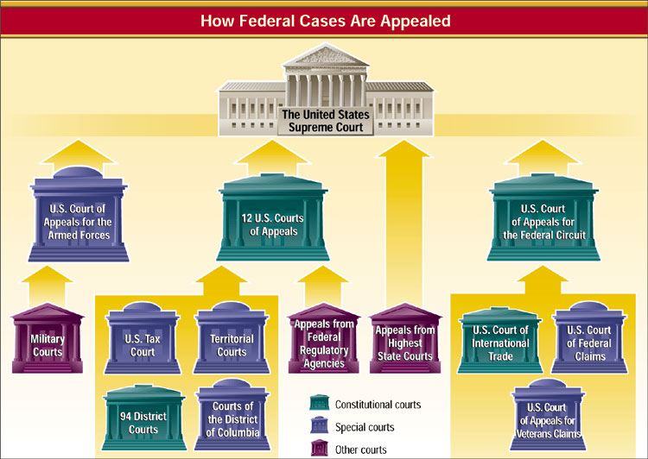
How Federal Cases Are Appealed
1
3
4
Chapter 18, Section 2

Slide 6
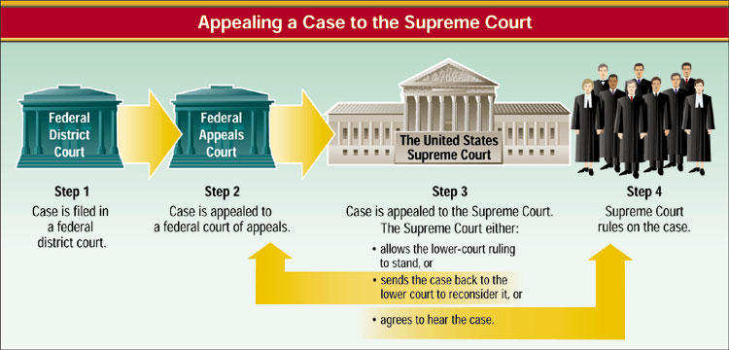
Appealing a Case to the Supreme Court
1
2
4
Chapter 18, Section 3

Slide 7
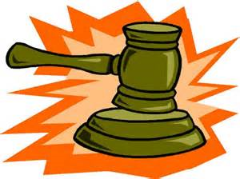
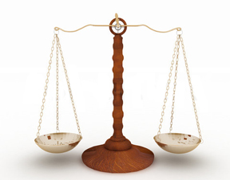
SUPREME COURT
SHAPING POLICY
President
Sees that
laws are
carried out
Directs the executive agencies
Congress
Passes
laws
Reviews
budgets of
executive
agencies
PROCEDURES OF THE COURT
(P. 521 – 522)
ORAL ARGUMENTS –
BRIEFS –
CONFERENCE –
OPINION –
Supreme Court
Interpret laws
Judicial Review
Override/Reverse Decisions
REACHING THE
SUPREME COURT(P. 520 – 521)
RULE:
-
HOW CASES REACH COURT:
1.
2.

Slide 8
SUPREME COURT PROCEDURES
CHAPTER 18

Slide 9
How Cases Reach the Supreme Court
For a case to be heard by the Court, four of nine judges must agree that it should be placed on the Court’s docket.
Writ of Certiorari
Most cases reach the Court via writ of certiorari, an order to a lower court to send a record in a given case for its review.
Certificate
Cases can reach the Court by certificate when a lower court asks for the Court to certify the answer to a specific question in the matter.
1
2
4
Chapter 18, Section 3

Slide 10
How the Supreme Court Operates
Oral Arguments
Once the Supreme Court accepts a case, it sets a date on which lawyers on both sides will present oral arguments.
Briefs
Briefs are written documents filed with the Court before oral arguments begin.
The Court in Conference
The Chief Justice presides over a closed-door conference in which justices present their views on the case at hand.
1
2
4
Chapter 18, Section 3

Slide 11
Opinions of the Court
Once the Court finishes its conference, it reaches a decision and its opinion is written.
1
2
4
Chapter 18, Section 3

