Slide 1
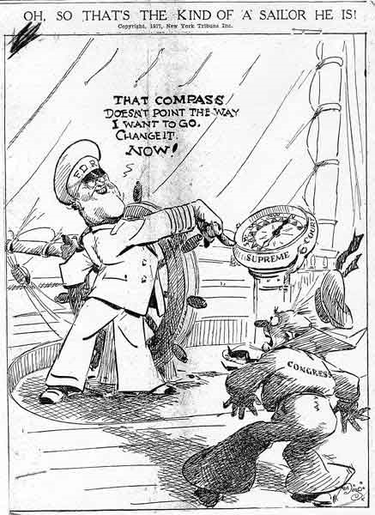
Thursday April 23, 2015 Mr. Goblirsch – American Government
OBJECTIVE – Students Will Be Able To – SWBAT:
- Simulate the judicial review power and procedures of the Supreme Court
AGENDA:
WARM-UP: Political Cartoon
CONCEPT: Shaping Public Policy
DISCUSSION: Procedures of the Supreme Court
SIMULATION: Judicial Review
***HW DUE NEXT TUESDAY – Jury Duty Interviews***
Political Cartoon WARM-UP: (Follow the directions below)
***5 minutes***
Answer the questions below.
In 1937, President Roosevelt proposed a law
that would have allowed him to appoint as
many as six new Supreme Court justices. He
was widely criticized for trying to “pack the court”
with judges favorable to his New Deal programs.
Who is the captain?
Who does the smaller sailor represent?
How is the Supreme Court represented?
How does the cartoonist portray FDR’s plan?

Slide 2
HW: Jury Duty Interviews
Conduct 3 interviews of people who have had jury duty. Ask them to recall their impressions of the experience.
(EX. – What was the case? How long did it last? How did the deliberations go? What’s the best excuse you heard to try and get out of jury duty? Etc.)
Try to find people who have actually served during the trial, not just people who were dismissed.
After conducting the interview, write a brief paragraph summary of each person’s responses.

Slide 3
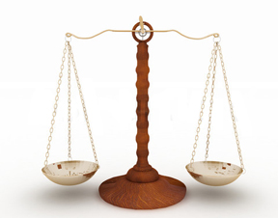
SUPREME COURT
SHAPING POLICY
President
Sees that
laws are
carried out
Directs the executive agencies
Congress
Passes
laws
Reviews
budgets of
executive
agencies
PROCEDURES OF THE COURT
(P. 521 – 522)
ORAL ARGUMENTS –
BRIEFS –
CONFERENCE –
OPINION –
Supreme Court
Interpret laws
Judicial Review
Override/Reverse Decisions
REACHING THE
SUPREME COURT(P. 520 – 521)
RULE:
-
HOW CASES REACH COURT:
1.
2.

Slide 4
Court Case #1
An African-American man was not allowed to sit in certain section on a public railroad. He argued to the Supreme Court that his 14th amendment right was violated.
Court Case #2
An African-American girl was not allowed to attend her neighborhood public school. She argued to the Supreme Court that her 14th amendment right had been violated.

Slide 5
Court Case #1
An African-American man was not allowed to sit in certain section on a public railroad. He argued to the Supreme Court that his 14th amendment right was violated.
1896
Plessy v. Ferguson – “reasonable exercise of power.” Segregation in public facilities allowed (Separate but equal)

Slide 6
Court Case #2
An African-American girl was not allowed to attend her neighborhood public school. She argued to the Supreme Court that her 14th amendment right had been violated.
1954
Brown v. Board of Education of Topeka – “Segregation is a denial of the equal protection of the laws.” Ended separate but equal

Slide 7
JUDICIAL REVIEW SIMULATION
***Need 1 Volunteer to be a Death Penalty advocate
***Need 1 Volunteer to be a Death Penalty opponent
Each State will act as the Supreme Court
Each Section Leader will act as the Chief Justice
Step 1 – Oral arguments: Each volunteer will make their case for/against the Death Penalty
Step 2 – Briefs: Each Supreme Court (State) will read the handout
Step 3 – Conference: The Chief Justice will be in charge of conducting a conference discussion amongst the group. After all members are heard, a vote will be taken to determine the decision of the court.
Step 4 – Opinions: All members who support the decision will contribute to writing the Majority Opinion. All members who disagree with the decision will contribute to writing the Dissenting Opinion.

Slide 8
SIMULATION ISSUE:
Death Penalty
EIGHTH AMENDMENT:
“Excessive bail shall not be required, nor excessive fines imposed, nor cruel and unusual punishment inflicted”
SCENARIO:
A citizen has been found guilty of murder one (premeditated/planned). The court has ruled in favor of sentencing the citizen to death as allowed by it’s State law. The citizen has appealed this ruling and now the Supreme Court has decided to hear this case.
ISSUE:
Does the State law permitting the Death Penalty violate the 8th Amendment of the Constitution?

Slide 9
CLASS RANKINGS
CLASS AVERAGE
PURCHASED FINAL
5th – 71%
6th – 74%
4th – 77.52%
3rd – 77.85%
4) 5th – 74%
6th – 88%
3rd – 97%
1) 4th – 100%

Slide 10
How the Supreme Court Operates
Oral Arguments
Once the Supreme Court accepts a case, it sets a date on which lawyers on both sides will present oral arguments.
Briefs
Briefs are written documents filed with the Court before oral arguments begin.
The Court in Conference
The Chief Justice presides over a closed-door conference in which justices present their views on the case at hand.
1
2
4
Chapter 18, Section 3

Slide 11
Opinions of the Court
Once the Court finishes its conference, it reaches a decision and its opinion is written.
1
2
4
Chapter 18, Section 3

Slide 12
LIST OF INDIVIDUALS WHO HAVE NOT PAID FOR THE FINAL
3RD PERIOD
Andrea C.
Total Have Not Paid
= 1 / 31

Slide 13
LIST OF INDIVIDUALS WHO HAVE NOT PAID FOR THE FINAL
4TH PERIOD
Total Have Not Paid
= 0 / 31

Slide 14
LIST OF INDIVIDUALS WHO HAVE NOT PAID FOR THE FINAL
5TH PERIOD
Rudi G.
Ernesto G.
Izaiah H.
Alex H.
Erasmo P.
Rafael R.
Oscar T.
Chris T.
Genesis V.
Total Have Not Paid
= 9 / 35

Slide 15
LIST OF INDIVIDUALS WHO HAVE NOT PAID FOR THE FINAL
6TH PERIOD
Rolando C.
Hannah G.
Abel M.
Julio O.
Total Have Not Paid
= 4 / 34

