Slide 1
Tuesday September 8, 2015 Mr. Goblirsch – U.S. History
OBJECTIVE – Students Will Be Able To – SWBAT:
Identify the causes & effects of the Civil War.
AGENDA:
WARM-UP: Civil War Photography
CONCEPT: Civil War Causes
READING: Lincoln’s Vindication
JIGSAW: Civil War Impact
*****Unit 1 Project–Early America Newspaper–DUE TUES 9/15
Civil War Photography WARM-UP: (Follow the directions below)
***5 Minutes***
Analyze the pictures on Pg. 178.
Compare the 2 photographs. What do you see in each?
How do these photos compare with more heroic imagery of traditional history painting?
Compare these pictures with the painting on P. 181, which image(s) seem more realistic and why?

Slide 2
Causes and Effect of the Civil War
Causes
CIVIL WAR
EFFECTS/IMPACTS
Costs
Improvements
In
Technology
Economics
Political
Social

Slide 3
Causes and Effect of the Civil War
Causes
Different regional economies – Industrial/Market vs. Plantation/Cotton
CIVIL WAR
EFFECTS/IMPACTS
Costs
Improvements
In
Technology
Economics
Political
Social

Slide 4
Causes and Effect of the Civil War
Causes
Different regional economies – Industrial/Market vs. Plantation/Cotton
Abolition movement, Underground Railroad
CIVIL WAR
EFFECTS/IMPACTS
Costs
Improvements
In
Technology
Economics
Political
Social

Slide 5
Causes and Effect of the Civil War
Causes
Different regional economies – Industrial/Market vs. Plantation/Cotton
Abolition movement, Underground Railroad
Politics of slavery - New Territories, Fugitive Slave laws
CIVIL WAR
EFFECTS/IMPACTS
Costs
Improvements
In
Technology
Economics
Political
Social

Slide 6
Causes and Effect of the Civil War
Causes
Different regional economies – Industrial/Market vs. Plantation/Cotton
Abolition movement, Underground Railroad
Politics of slavery - New Territories, Fugitive Slave laws
Dred Scott Supreme Court decision
CIVIL WAR
EFFECTS/IMPACTS
Costs
Improvements
In
Technology
Economics
Political
Social

Slide 7
Causes and Effect of the Civil War
Causes
Different regional economies – Industrial/Market vs. Plantation/Cotton
Abolition movement, Underground Railroad
Politics of slavery - New Territories, Fugitive Slave laws
Dred Scott Supreme Court decision
Election of Lincoln = Southern secession
CIVIL WAR
EFFECTS/IMPACTS
Costs
Improvements
In
Technology
Economics
Political
Social

Slide 8
Causes and Effect of the Civil War
Causes
Different regional economies – Industrial/Market vs. Plantation/Cotton
Abolition movement, Underground Railroad
Politics of slavery - New Territories, Fugitive Slave laws
Dred Scott Supreme Court decision
Election of Lincoln = Southern secession
Lincoln’s determination to preserve the Union
CIVIL WAR
EFFECTS/IMPACTS
Costs
Improvements
In
Technology
Economics
Political
Social

Slide 10
COSTS
Over 350,000 Union deaths
Over 250,000 Confederate deaths
= Over 600,000 total casualties
Price for War:
Union - $2.3 billion
Confederacy - $1 billion

Slide 11
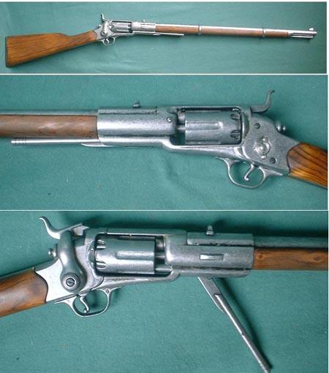
Technological Impact: New Improved Weapons
The Rifle, minie ball bullet, hand grenades, land mines

Slide 12
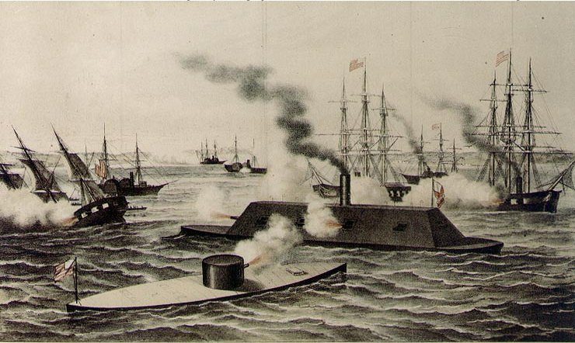
Ironclad Warships
Monitor (N) & Merrimack (S)

Slide 13
Economic Impact:
Inflation; National debt increased
Northern economy boomed, widening the gap between the N and S
Southern economy Devastated; End of slavery as a labor system, Total War = much of the regions industry, railroads, & farmland destroyed

Slide 14
Political Impact:
Increased Power & Authority of Fed Govt
- During the war passed conscription & income tax laws (more control over the individual)
- States’ did not have the right to secede from the Union

Slide 15
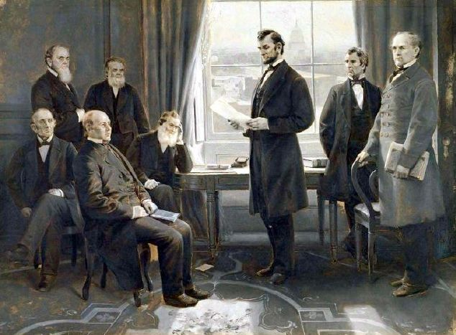
Social Impact: Emancipation Proclamation & 13th Amendment
Eman. Proc. - Union Troops could set Slaves Free in Confederate States

Slide 16
Social Impact Cont’d
Solution to Slavery Problem
13th Amendment to The Constitution
( Broke the Chains Everywhere in US)

