Slide 1
Monday September 14, 2015 Mr. Goblirsch – Economics
OBJECTIVE – Students Will Be Able To – SWBAT:
- Explain the basic principles, the role of the consumer, and the role of the government in the American free enterprise system.
AGENDA:
WARM-UP: “Land of Opportunity” Journal
CONCEPT: American Free Enterprise System (NearPod)
GROUPS: Externalities
ASSIGNMENT: Chapter 3 Vocab Boxes
***Unit 1 Test THURSDAY 9/17 (Chapters 1, 2, 3, & 8)***
“Land of Opportunity” Journal WARM-UP: (Follow the directions below)
***5 minutes***
Write a ½ page journal entry on the topic below:
For centuries, America has often been referred to as the “land of opportunity.” Explain in your own words 1) what you think this means, 2) why you think America is called that.

Slide 2
Chapter 3: American Free Enterprise
◆ Benefits of Free Enterprise
❖ Promoting Growth & Stability
⬥ Providing Public Goods
 Providing a Safety Net

Slide 3
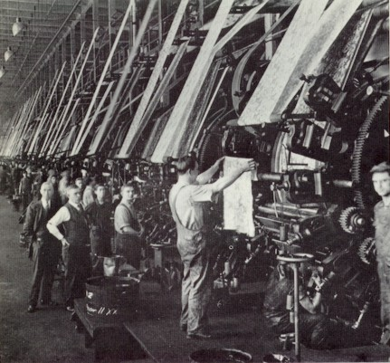
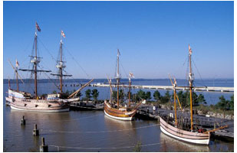
PRIOR KNOWLEDGE: Benefits of Free Enterprise
CHARACTERISTICS:
Property Rights
Profit Motive
Open Opportunity
Voluntary Exchange
Competition

Slide 4
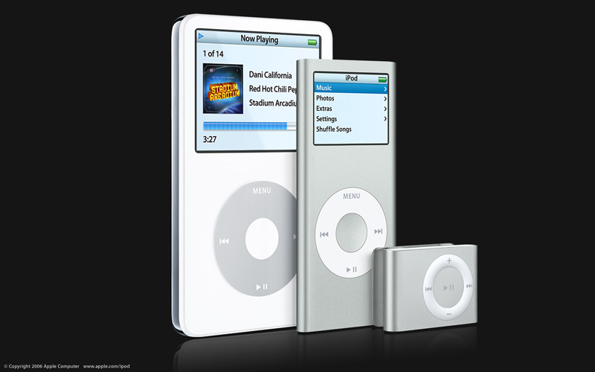
The Role of the Consumer
➢ Consumers make their desires known through purchases
➢ Tells Producers:
• What to produce
• How much to produce

Slide 5
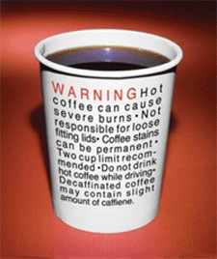
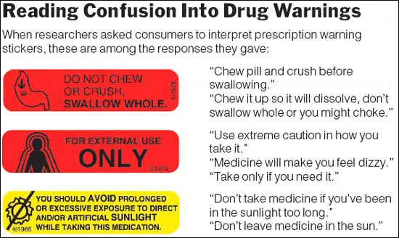
The Role of the Government
Educate Consumers
Public Disclosure laws
Protect the Health, Welfare & safety of Society

Slide 6
STRUCTURED ACADEMIC DISCUSSION:
The role of the consumer in the American Free Enterprise system is …
The role of the government in the American Free Enterprise system is …

Slide 7
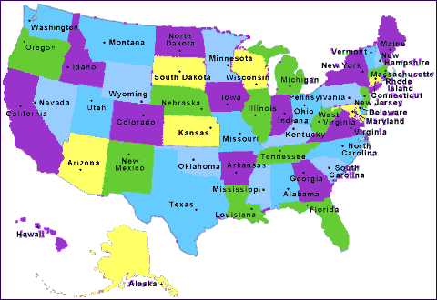
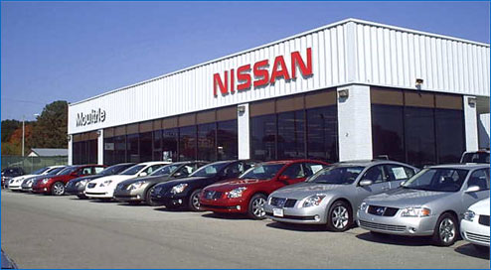
Section 2: Promoting Growth & Stability
Macroeconomics
➢ Deals with the entire economy.
Microeconomics
➢ Deals with specific markets

Slide 8
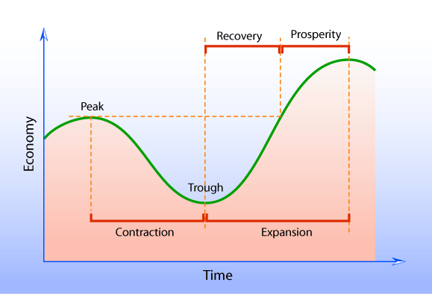
Tracking Business Cycles
Gross Domestic Product (GDP)
➢ Total of all G & S produced within a country’s border
Business Cycle
➢ Graph showing the ups and downs of GDP

Slide 9
STRUCTURED ACADEMIC DISCUSSION:
The difference between macroeconomics and microeconomics is …
GDP is …

Slide 10
Promoting Economic Strength
◆ Employment
❖ Growth
⬥ Stability
 Economic Citizenship
➢ Voting to change economic policy

Slide 11
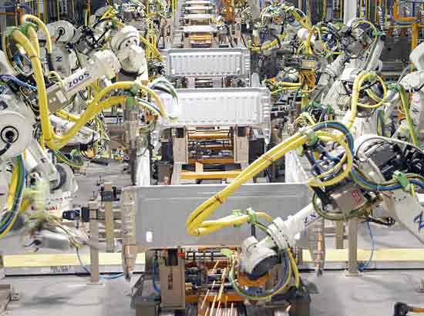
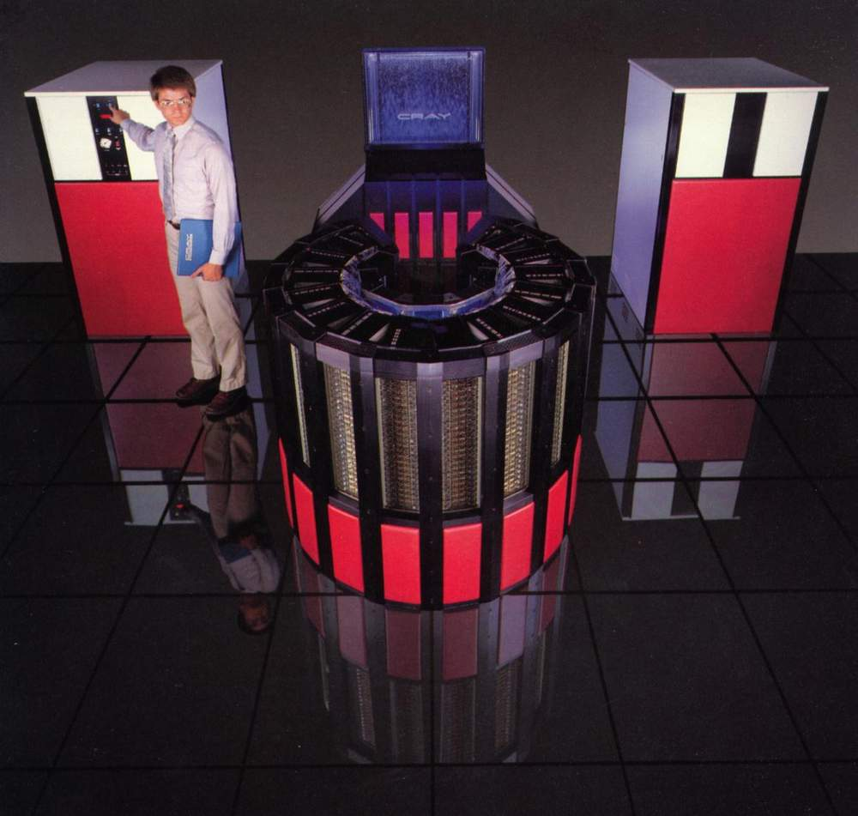
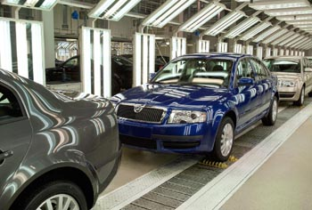
Technology & Productivity
Technology increases Productivity
· Innovation
Assembly lines
Computers
Robots

Slide 12
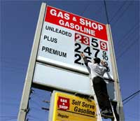
Negative Effects of Regulation
➢ Costs Businesses
➢ Costs Consumers
➢ Must establish a Cost Benefit Analysis

Slide 13
STRUCTURED ACADEMIC DISCUSSION:
The government promotes economic strength by …
Sometimes government involvement can have a negative effect because …

Slide 14
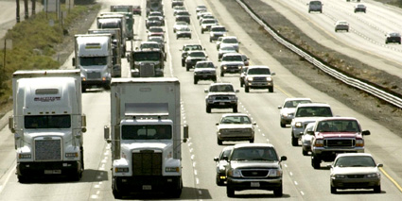
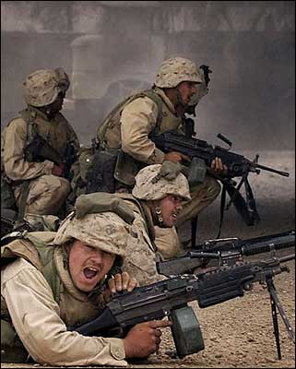
Section 3: Providing Public Goods
When Free Market doesn’t provide the government will
Market Failure when the market doesn’t provide.
Free Riders are a problem.

Slide 15
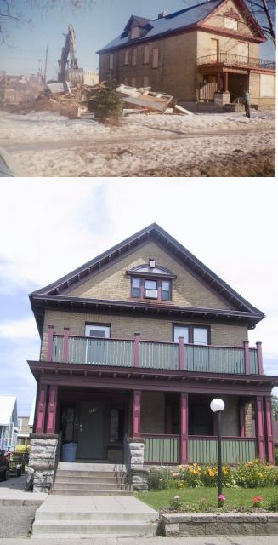
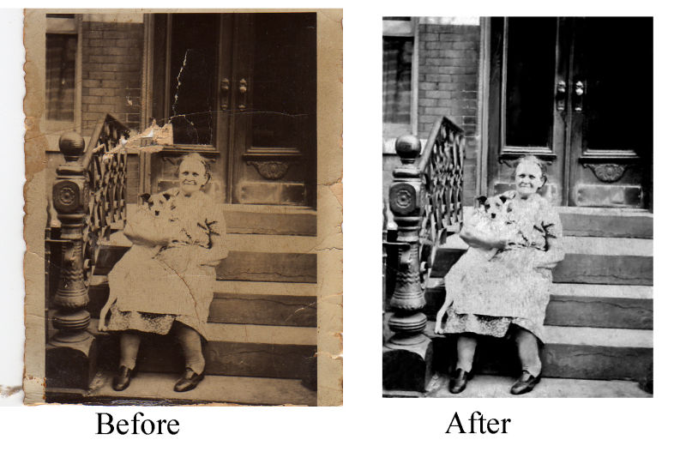
Positive Externalities a beneficial side effect of economic activity

Slide 16
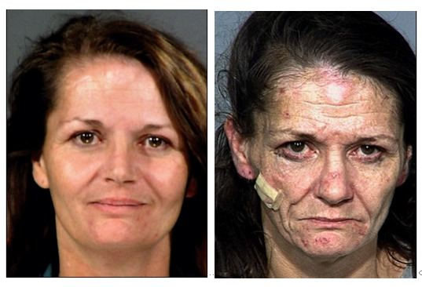
Negative Externality: _____________________________________________
Drug Use – Environmental Issues (Radiation)

Slide 17
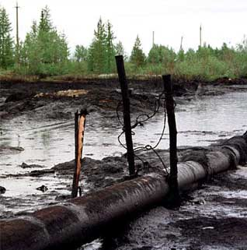
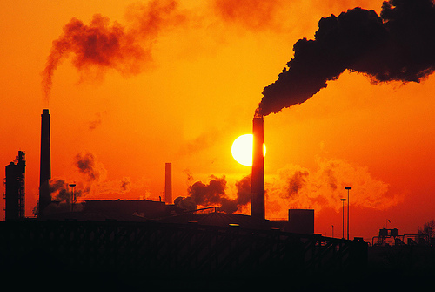
Negative Externality: a harmful side effect of economic activity
Pollution

Slide 18
EXTERNALITIES
DIRECTIONS: Create a list of the positive and negative externalities of the scenario below.
SCENARIO: The city of Ceres is deciding to purchase an abandoned business complex and the surrounding homes. The city wants to destroy the structures and turn the land into a recreational park for city dwellers, complete with baseball fields, basketball courts, tennis courts, a swimming pool, and a bicycle path. Some of the city leaders support the plan and others condemn it. Work with your pod to speculate on both sides of why some feel it is a good idea, and others feel it is not a good idea.
POSITIVE
NEGATIVE

Slide 19
CLOSURE: Chapter 3 Vocab Boxes
For each of the terms below, complete a Vocab box like seen to the right:
Profit Motive
Competition
Private Sector
Public Sector
Free Rider
VOCAB TERM
Definition in your own words | Picture, Logo, Cartoon to demonstrate definition
***Complete the Vocab Boxes on a separate
piece of paper in order to turn it in
DUE WEDNESDAY - 9/16

