Slide 1
Tuesday September 23, 2014 Mr. Goblirsch – Economics
OBJECTIVE – Students Will Be Able To – SWBAT:
- Simulate creating a business.
AGENDA: 4th PERIOD ONLY
WARM-UP: Log-In
Review Business Project Directions
Begin Working on Business Project
Raise your hand if you have a question or need help
*Business Project DUE TUESDAY Sept 30*
– Make sure you complete Part 1 & Part 2 of the Business Project
***$10 Dollar Assignment – DUE FRIDAY SEPT 26 – Winner gets $250 bonus
Log-In WARM-UP: (Follow the directions below)
***2 minutes***
Log-In to a Computer

Slide 2
Tuesday September 23, 2014 Mr. Goblirsch – Economics
OBJECTIVE – Students Will Be Able To – SWBAT:
- Explain the law of demand and interpret a demand graph using demand schedules.
AGENDA: 3rd, 5th, & 6th PERIODS
WARM-UP: Demand Journal
CONCEPT: Demand
POLITICAL CARTOON: “I Demand!”
INDEPENDENT PRACTICE: Ch 4-1: Demand Vocab Boxes
*Business Project DUE TUESDAY Sept 30*
– Make sure you complete Part 1 & Part 2 of the Business Project
***$10 Dollar Assignment – DUE FRIDAY SEPT 26 – Winner gets $250 bonus
Demand Journal WARM-UP: (Follow the directions below)
***5 minutes***
Write a paragraph journal entry on the topic below.
When you go shopping for new clothes, what is the most important thing when you consider buying something new? Is it price, or style, or brand, or something else? Explain your answer.

Slide 3
Chapter 4: Demand
Section 1: Understanding Demand
Section 2: Shifts of the Demand Curve
Section 3: Elasticity of Demand

Slide 4
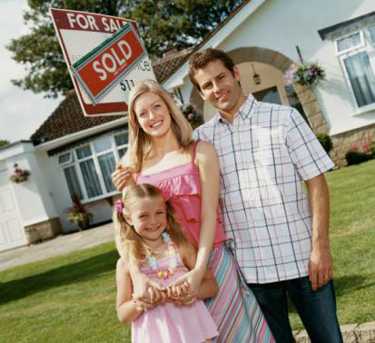
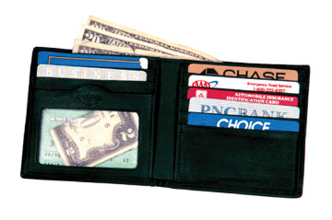
Section 1: Understanding Demand
Demand
Two Parts:
The desire to own something.
❖ The Ability to pay for it.

Slide 5
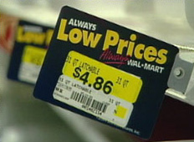
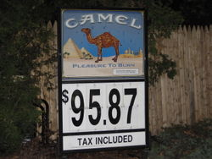
Section 1: Understanding Demand
The Law of Demand
When a good’s price is lower, consumers will buy more of it.
I like low prices!!
It costs too much! I’m going to quit!!!
When a good’s price is higher, consumers will buy less of it.
P$ = QD
P$ = QD

Slide 6
Demand Schedules & Graphs
Demand Schedule
Price of of a slice of pizza | Quantity Demanded
Demand Graph
Price
$3.00
$2.50
$2.00
$1.50
$1.00
$0.50
$0.50
5
$1.00
4
$1.50
3
$2.00
2
$2.50
1
D
$3.00
0
0 1 2 3 4 5 Q

Slide 7
“I DEMAND” Political Cartoon
DIRECTIONS: Discuss the questions below based off the “I Demand” political cartoon.
What roles does Calvin claim to play in this cartoon?
What groups/people is Calvin critical of in this cartoon?
How does Calvin misinterpret the idea of economic Demand?
What political statements are made from this cartoon?

Slide 8
INDEPENDENT PRACTICE: Chapter 4-1: DemandVocab Boxes
For each of the terms below, complete a Vocab box like seen to the right:
Demand
Law of Demand
Substitution effect
Income effect
VOCAB TERM
Definition in your own words | Picture, Logo, Cartoon to demonstrate definition
***Complete the Vocab Boxes on a separate
piece of paper in order to turn it in
DUE TOMORROW

