Slide 1
Tuesday October 14, 2014 Mr. Goblirsch – U.S. History
OBJECTIVE – Students Will Be Able To – SWBAT:
Explain how and why the Populist Party gained support.
AGENDA:
WARM-UP: “One American’s Story”
CONCEPT: Rise & Fall of Populism
GUIDED READING: Analyzing Populism Documents
INDEPENDENT PRACTICE: Chapter 5 Review Questions - DUE WEDNESDAY
VIDEO CLIP: Life on the Great Plains (7 min)
***Unit 1 Foldable DUE TODAY***
“One American’s Story” WARM-UP: (Follow the directions below)
***5 Minutes***
Read “One American’s Story” of Mary Elizabeth Lease on P. 219.
Who is Mary Elizabeth Lease speaking up for?
Why do you think M.E.L. gained support as a vocal promoter of the cause of farmers?

Slide 2
The Rise and Fall of the Populist Party
1867-1896

Slide 3
Farmers’ Problems
Crop prices fell
Farmers had no cash, went further into debt, and their lenders foreclosed on their mortgages
The railroad companies charged outrageous prices to ship crops (no regulation!)

Slide 4
ECONOMIC DISTRESS HITS FARMERS
Between 1867 and 1887 the price of a bushel of wheat fell from $2.00 to 68 cents
Railroads conspired to keep transport costs artificially high
Farmers got caught in a cycle of debt

Slide 5
Farmers’ Demands
Regulate the railroad companies (Stop them from charging such high rates)
Make cash more available (back the dollar with silver, not gold, so dollar would be worth less)
Constitutional demands: single term for President and Vice-President, secret ballot, popular election of Senators
To get industrial workers to support them: 8-hour workday, restrict immigration

Slide 6
Different Groups Representing Farmers’ Interests
1867: The Patrons of Husbandry (The Grange)
1880s: Farmers’ Alliance and Colored Farmers’ National Alliance
1892: Birth of the Populist, or People’s Party

Slide 7
POPULIST REFORMS
Proposed economic reforms included:
increase of money supply
a rise in crop prices
lower taxes
a federal loan program
Proposed political reforms included:
direct election of senators
single terms for presidents
Populists also called for:
8-hour workday
reduced immigration

Slide 8
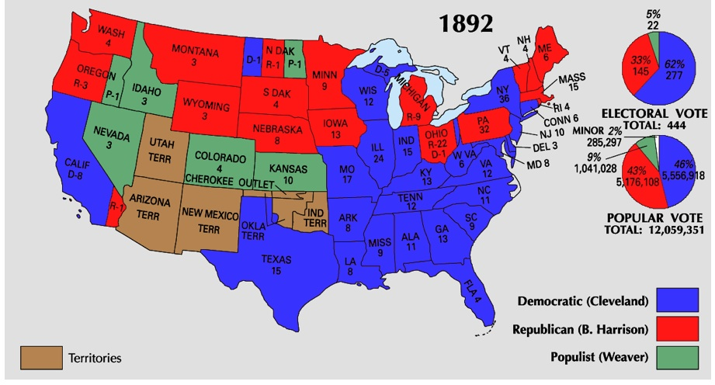
1892 Presidential Election: Populist candidate won over a million votes!

Slide 9
THE PANIC OF 1893
Nationwide economic problems took center stage in America in 1893
Railroads went bankrupt, the stock market lost value, 15,000 businesses and 500 banks collapsed,
3 million people lost their jobs – putting unemployment at 20%
THE STOCK MARKET CRASHED IN 1893

Slide 10
1896 Election
Democrats – 1890s | Republicans – 1890s
Southerners Wealthy farmers Supported low tariffs (wanted other countries to buy their crops) | Northerners Wealthy business men (connected to the railroad) Southern African Americans (poor farmers) Supported high tariffs (didn’t want to compete with other countries’ products)

Slide 11
1896 Election
Populists decide to improve their chances by supporting the Democratic candidate, William Jennings Bryan, who agreed to support the silver-backed dollar.

Slide 12
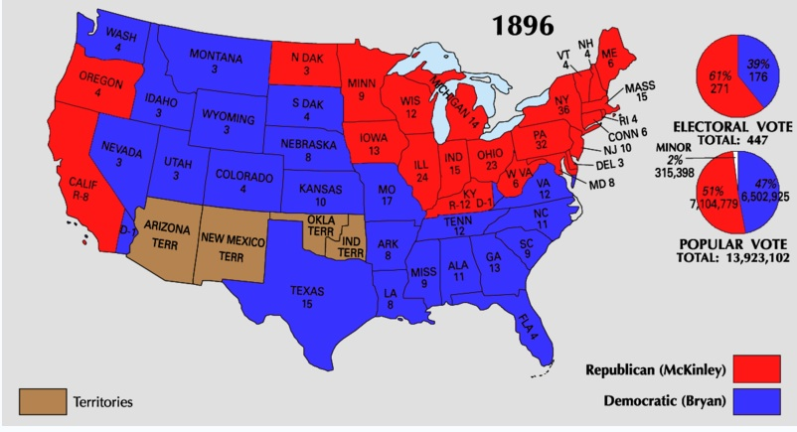
1896 Presidential Election: Bryan loses but carries most of the South and West

Slide 13
Central Historical Question
Why did the Populist Party attract millions of supporters?

Slide 14
GUIDED READING
Sourcing: Who wrote this? When?
Contextualization: What was going on for farmers at the time?

Slide 15
Central Historical Question
Why did the Populist Party attract millions of supporters?

Slide 16
THE END OF POPULISM
With McKinley’s election victory, Populism collapsed, burying the hopes of the farmer
Populism left two important legacies: 1) A message that the downtrodden can organize and be heard and 2) An agenda of reforms, many of which would be enacted in the 20th century
THE PEOPLE’S PARTY WAS SHORT-LIVED BUT LEFT AN IMPORTANT LEGACY

Slide 17
Ch 5 Review Questions
DIRECTIONS: Use your notes and textbook to answer the following questions on a separate piece of paper. DO NOT WRITE DOWN THE QUESTION. Answer them in complete sentences.
Conflicts between Native Americans and the United States were largely over what? (Ch 5 Sec 1 P. 203)
What impact did the railroads have on the West? (Ch 5 Sec 2 P. 215)
In what ways did the government encourage settlement on the Great Plains? (Ch 5 Sec 2 P. 215)
How did new inventions and the Morrill Act change farming on the Great Plains? (Ch 5 Sec 2 P. 217)
Why did farmers think that an increased money supply would help solve their economic problems? (Ch 5 Sec 3 P. 220)
What reforms did the Populist party want to implement? (Ch 5 Sec 3 P. 221)
On P. 220, Answer Analyzing Political Cartoons Question #1.
On P. 220, Answer Analyzing Political Cartoons Question #2.

