Slide 1
Tuesday October 28, 2014 Mr. Goblirsch – Economics
OBJECTIVE – Students Will Be Able To – SWBAT:
- Identify the different forms of monopolies and 2 market structures: monopolistic competition and oligopoly.
AGENDA:
WARM-UP: Perfect Competition vs. Monopoly
CHART: Types of Monopolies
VIDEO CLIP: Khan Academy: Monopolistic & Oligopoly (9 min)
CONCEPT: Market Structures
INDEPENDENT PRACTICE: Workbook P. 39 – DUE THURSDAY
*****Unit 2 (Chapters 4 – 7) Test THURSDAY*****
Perfect Competition vs. Monopoly WARM-UP: (Follow the directions below)
***5 minutes***
Write a paragraph answering the question below.
How is a market with Perfect Competition different from a market with a Monopoly? Use the handout to support your answer.

Slide 2
CH. 7 Market Structures

Slide 3
Types of Monopolies
DIRECTIONS: Read P. 158-160. Complete the Chart below.
TYPE | DESCRIPTION
Natural Monopoly
Government Monopoly
Technological Monopoly
Franchises & Licenses
Industrial Organizations
Geographical Monopoly

Slide 4
Natural Monopolies
high fixed costs
permits to operate are granted
price is regulated
example—utilities TID, MID, PG&E

Slide 5
Governmental Monopolies
a monopoly the government owns and operates
examples—USPS and lotteries

Slide 6
Technological monopolies
patents, copyrights, franchises, and licenses
gives an advantage to those who posses them

Slide 7
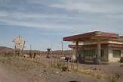
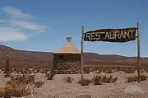
Geographical Monopoly
No other sellers in the area

Slide 8
Market Structures

Slide 9
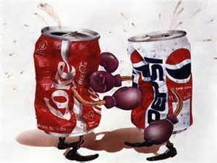
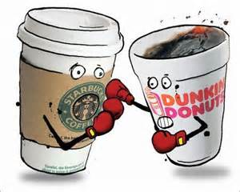
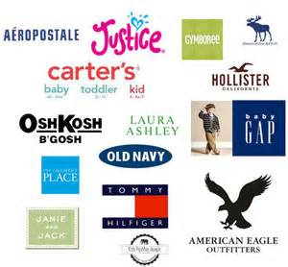
Monopolistic Competition
Many companies compete in an open market to sell similar products

Slide 10
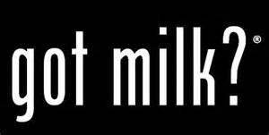
Non-Price Competition
Physical characteristics
Location
Service level
Advertising, image, or status

Slide 11
Market Structures

Slide 12
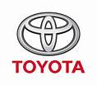
Oligopoly
A few large firms dominate the market
High barriers to entry
Cooperation and collusion
avoid price competition—if one firm lowers prices, others tend to follow
price fixing
Cartels
a formal organization that agrees to coordinate prices and production
example—OPEC

Slide 13
Market Structures

Slide 14
UNIT II STUDY GUIDE
MULTIPLE CHOICE
3 stages of production
Demand & Supply
Law of Demand & Supply
Market Structures:
Perfect competition
Monopolistic competition
Oligopoly
Monopoly
ANALYZING GRAPHS
Demand & Supply
Changes in Demand & Supply
ANALYZING EQUILIBRIUM
Price & Quantity
Result of a price ceiling
Changes in Eq. price & Eq. quantity when supply & demand shift

