Slide 1
Tuesday January 13, 2015 Mr. Goblirsch – American Government
OBJECTIVE – Students Will Be Able To – SWBAT:
- Relate the categories of Federal Spending to the 6 purposes of government outlined in the Preamble.
AGENDA:
WARM-UP: Democracy Quote
DISCUSSION: Preamble & Federal Spending
1st CONGRESSIONAL VOTE: Minimum Wage
ASSIGNMENT: Workbook Pgs. 17 & 19
***HW: 2 Political Surveys – DUE FRIDAY (actually 8:00 pm Sunday)***
Democracy Quote WARM-UP: (Follow the directions below)
***5 minutes***
Analyze the quote below.
“Democracy is the recurrent suspicion that more than half of the people are right more than half of the time.” - E.B. White
What characteristic of democracy does this quote relate to? (Refer to your notes or P. 18 in your textbook.) What do you think the author meant by this quote?

Slide 2
Political Survey HW
You are to ask at least 2 people outside of school to take the Political Survey we took on the 1st day of school. You will be responsible for conducting the survey and inputting the results into the Google Form linked below. You can interview up to a total of 5 people for extra credit.
http://goo.gl/forms/Mn4PE5W7af

Slide 3
Preamble
“We the People of the United States
(1) in order to form a more perfect Union,
(2) establish justice,
(3) insure domestic tranquility,
(4) provide for the common defense,
(5) promote general welfare, and
(6) secure the blessings of liberty to ourselves and our posterity,
do ordain and establish this Constitution for the United States of America.”
STURCTURED ACADEMIC DISCUSSION:
I believe the loftiest (most expensive) goal of the preamble is ______________ because …

Slide 5
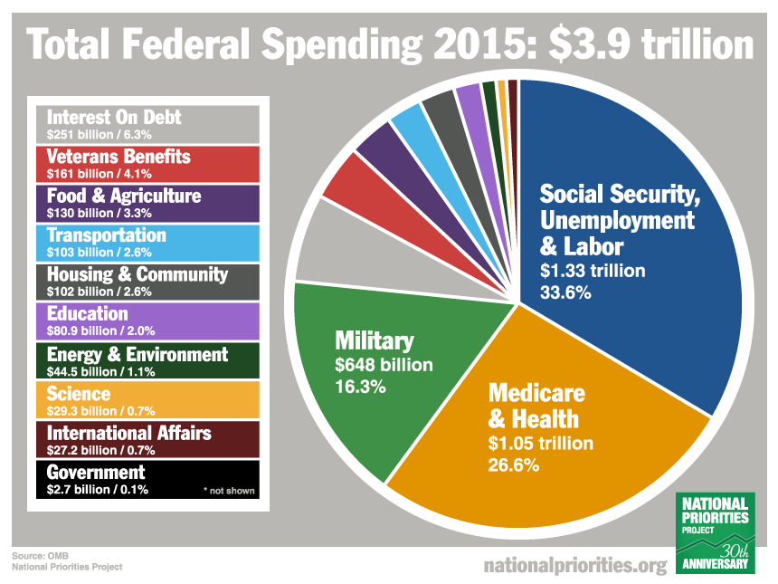

Slide 6
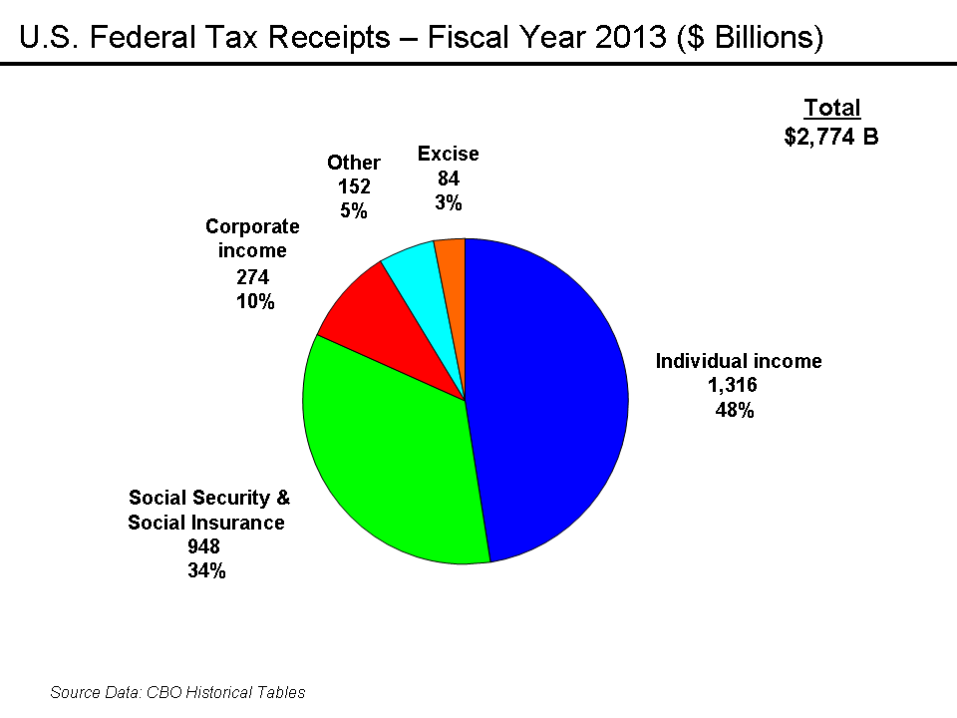

Slide 7
Here’s 2013 Federal spending all in one beautiful pie chart. If you master this, you’ll understand way more than most. The “fiscal year” actually begins October 1st of the year preceding, so we are already halfway through Fiscal Year (FY) 2014.
When Congress and the President cannot agree on a full-year budget, we often keep the government open using a series of Continuing Resolutions (CRs), which are temporary agreements to continue spending at pretty much existing levels. Last fall, the Republicans refused to agree on an FY 2014 budget or temporary CR that did not repeal the Affordable Care Act — hostage-taking the Democrats and President Obama would not allow — so the government shut down on Oct 1st 2013 for sixteen days until public pressure caused Republicans to cave.
Back to the chart... Everything shown in red is Mandatory spending, meaning it is dictated by existing law and very difficult to change without a battle royale. This makes up about 2/3 of the entire budget and includes benefit programs like Social Security (23%), Medicare (14%), Medicaid (8%), and other Income Security safety net programs (10%). Interest on the long-term debt (6%) is dictated by prevailing interest rates.
Everything shown in yellow is Discretionary spending, which is hammered out each year between Congress and the President. What I found most surprising is that almost all Military spending ($625 Billion), including war activities, is negotiated each year. And it makes up more than half of our Discretionary spending.
That leaves only about 16% of the entire budget — the little bitty 1% and 2% slivers in the lower right — that comprise the “non-defense discretionary” spending. It includes important investments like Education, Environment, Science and Transportation. And that’s where Republicans love to hack away. A $100 billion cut is less than 3% of the entire budget, but it’s a gigantic chunk out of just these little slivers.
Note that Social Security and Medicare each have a dedicated revenue stream through the payroll tax. Social Security’s 12.4% dedicated payroll tax currently covers its entire costs, so it is a 100% “earned benefit.” Medicare’s 2.9% dedicated payroll tax, however, was only designed to cover the Part A hospital portion. Because Medicare draws over $200 Billion per year from general tax revenues — for Part B (doctor/outpatient) and Part D (prescription drugs) — it can only be considered about 50% an earned benefit.
Also note that Foreign Aid is only about 1% of the budget (part of the Int’l Affairs sliver). In a recent poll, most people mistakenly believe it is a whopping 27% and that just eliminating foreign aid will solve our budget woes.

Slide 8
CONGRESSIONAL VOTE: Minimum Wage
PROPOSED BILL:
The current minimum wage in the state of California is $9.00, as of July 1, 2014. Therefore, the current minimum wage in Goblirsch’s class should be increased from $7.25 to $9.00.
A “Yes” vote will increase the minimum wage
A “No” vote will keep the minimum wage at it’s current level

Slide 9
BALLOT
Representative/Senator Name:
_________________________
_______________________
_____ YES
_____ NO

Slide 10
WORKBOOK ASSIGNMENT:
Complete Workbook Pg. 17 Part A only
Complete Workbook Pg. 19 Part A only
DUE THURSDAY

Slide 11
Congressional Name Tag
DIRECTIONS: Create your identification tag for our class Congress. It must include your House (ex. – Rep or Sen), First & Last Name, your Political Party, and your state.
EXAMPLES:
Rep. Mr. Goblirsch (R – CA)
Sen. Mr. Goblirsch (D – TX)
SYMBOLS:
House of Reps Member = Rep. ***Use the Map
Senate Member = Sen. to find State
Democrat = D abbreviation
Republican = R
Independent = I

Slide 12
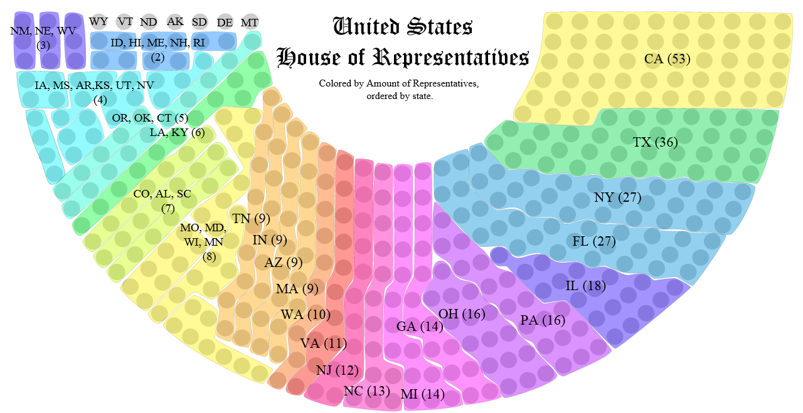
STATE SELECTION OPTIONS:
Big State = 15 – 53 Medium State = 5 – 14 Small State = 1 – 4

