Slide 1
Thursday August 21, 2014 Mr. Goblirsch – Economics
OBJECTIVE – Students Will Be Able To – SWBAT:
- Describe the societal values (economic goals) that determine how a country answers the 3 economic questions.
AGENDA:
WARM-UP: Opp. Cost Review
REVIEW: Production Possibilities & 3 Economic Questions
INSTRUCTION: Economic Goals
CLOSURE: What I need to Know for Tomorrow’s Quiz
***HW: Workbook P. 18 DUE TOMORROW***
*****Chapter 1 Quiz TOMORROW*****
Opp. Cost Review WARM-UP: (Follow the directions below)
***5 minutes***
Answer the following in a paragraph.
If your best friend asked you to borrow $100, would you loan it to them? Why or Why not?
Regardless of your answer to Part 1, if you DID loan your friend a $100 and he/she paid you back one year later, what was the opportunity cost of lending your friend the money?

Slide 2
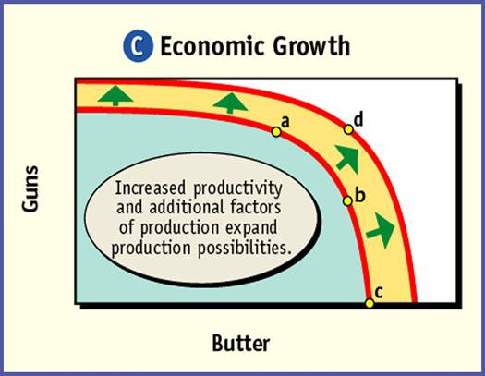
Section 3-17
REVIEWING Production Possibilities
Growth – always the goal
Figure 1.6 The Production Possibilities Frontier
“Guns” = Military
Goods
Operating at
Full Potential
“Butter” =
Consumer Goods

Slide 3
RECALLING YESTERDAY Answering the 3 Economic Questions
 ________________________?
 ________________________?
● ________________________?

Slide 4
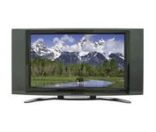
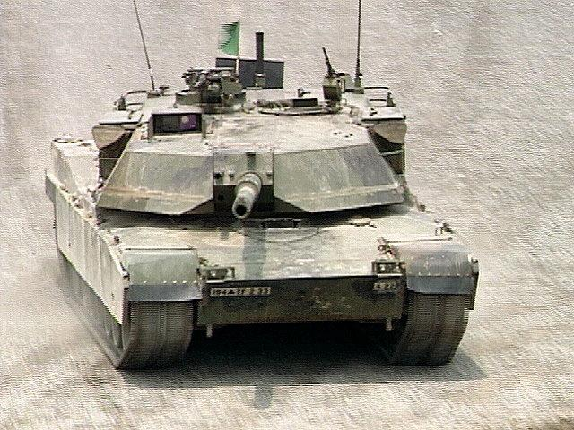
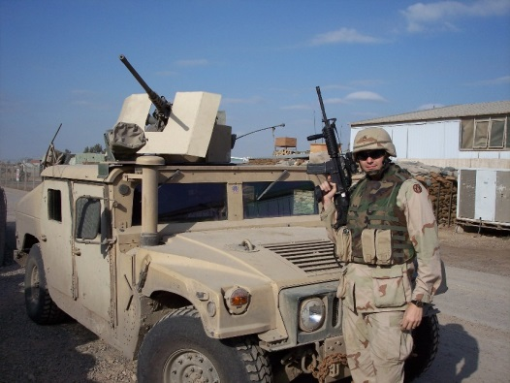
What to Produce?
What can we do best?
What are the Opportunity Costs?
Wants or needs?
Public Goods?
National Defense?
Education?
Public Health?
How Much?

Slide 5
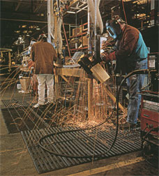
How to Produce?
How are you going to make your product?
➢ Assembly Line or Work Stations
➢ Corporate Farms or Family Farms
➢ Technology/Computers
➢ Robots or Humans

Slide 6
For whom to produce?
Markets
➢ Young or Old
➢ Male or Female
➢ Wealthy or Poor

Slide 7
Economic Goals & Societal Values
 Economic Efficiency
 Economic Freedom
● Economic Security & Predictability
❍ Economic Equity
■ Economic Growth & Innovation
□ Additional Goals

Slide 8
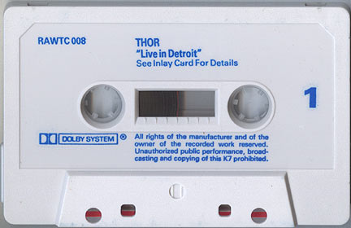
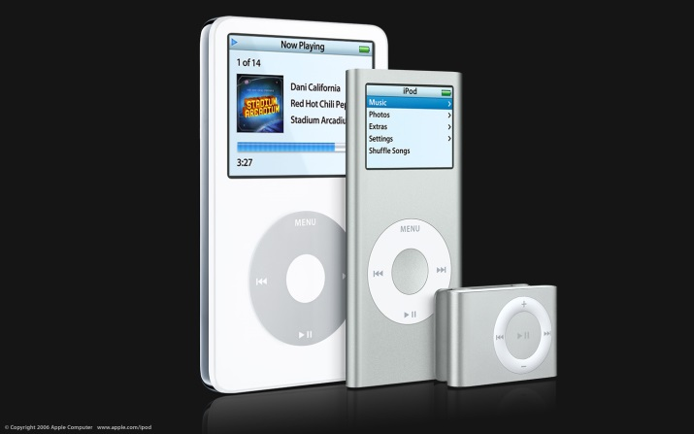
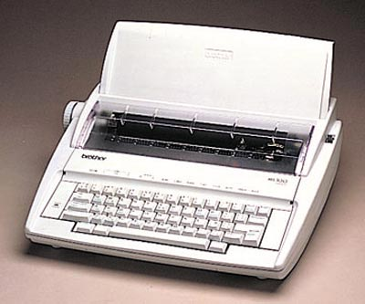
 Economic Efficiency
Society must maximize its scarce resources by accurately assessing:
“What to Produce?”
➢CDs or cassette tape
➢typewriters or computers

Slide 9
Higher Level Thinking
How can governments sometimes interfere with the economic goal of economic efficiency?

Slide 10
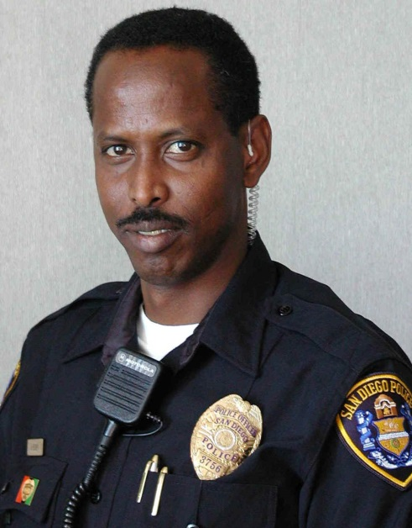
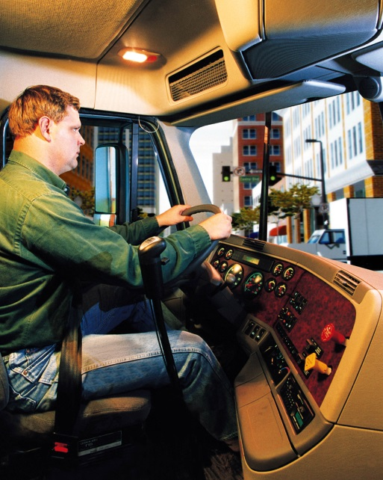
 Economic Freedom
You can be whatever you want to be

Slide 11
Higher Level Thinking
How can governments sometimes interfere with the economic goal of economic freedom?

Slide 12
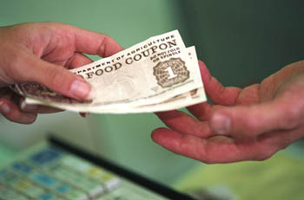
● Economic Security & Predictability
Economic Systems are there to ensure that people get what they want.
Government is there to ensure that we have safety nets to protect people in hard times.

Slide 13
Higher Level Thinking
The goal of Economic Security often clashes with the goals of Economic Freedom and Economic Efficiency.
Explain why this statement is true.

Slide 14
❍ Economic Equity
Who gets paid what?
Discrimination?
Disabled?

Slide 15
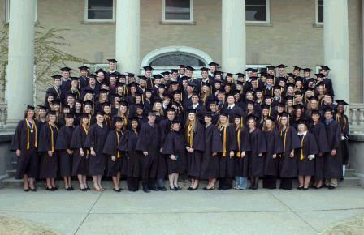
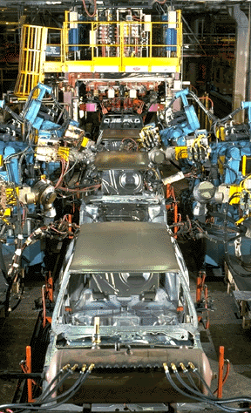
■ Economic Growth & Innovation
The economy must grow to create new jobs
innovations bring about efficiency and lowers prices

Slide 16
□ Additional Goals
Environmental Protections
Full Employment
Universal healthcare

Slide 17
CLOSURE: What Do I Need To Know For Tomorrow’s Quiz?
DIRECTIONS:
Work with your partner.
Go through your notebook and highlight this information to study tonight for tomorrow’s quiz
3 Basic Econ Questions
Factors of Production
Good vs. Service
Reading a Production Possibilities Curve
What’s the fundamental economic problem?
Opportunity cost
Relationship of Trade-Offs and Opportunity Costs

